Slide 1
Teeside SitP
Thursday 7th Feb 2019
Getting to First Base or What makes for a “good” argument?
An “expert-led” discussion format
by
Ian Glendinning

Slide 2
Outline – TeessideSitP, we have a problem.
Meta – Form of the evening
Communication – of the message.
Clarifying Discussion - of understanding of the intended message. (NB “First-base” - do not pass go.)
Free Discussion – of anything arising from the message.
Meta-Meta – The “message” is itself “meta”: About the nature of our communication processes – rather than any of the (many) specific example topics.
Because it’s meta(-meta) it’s more than science. It’s a proper integration of science and humanities (including philosophy, yes (!) even PoMo philosophy).
Choosing the right words for argument / dialogue?
Proper dialogue is hard work, takes time and commitment. Multiple priorities. Life’s too short?
Summary in rules.
Potential discussion topics / questions?

Slide 3
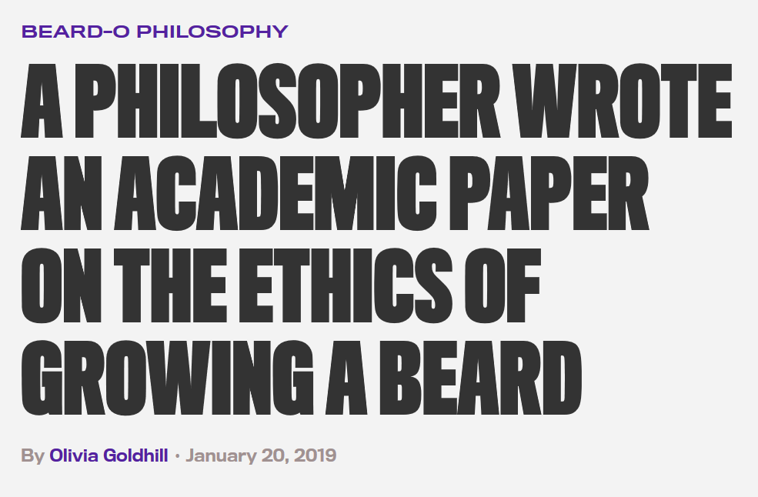
Angels on the head of a pin? Deckchairs on the Titanic?
As Massimo Pigliucci says – it gives “analytic” philosophy a bad name. Clearly its only value is as an exercise in understanding the form and processes of such an argument. The specific argument and any conclusions are (almost certainly) entirely useless. It’s Meta to “the real world”.

Slide 4
Science “versus” Humanities Two Cultures as Silos?
“Science”
& STEM
(Objective Stuff)
“Humanities”
& the Arts
(Subjective Stuff)
Scientists appreciate / value / use / inspire art.
Artists appreciate / value / use / inspire science.
(But each “silo” has internal processes and values that aim to keep the other at bay?)

Slide 5
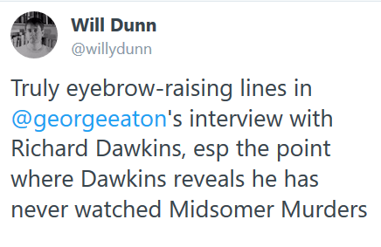
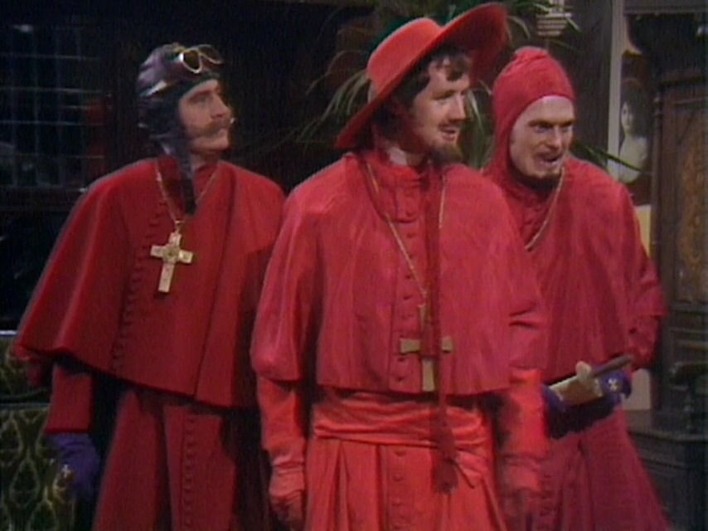
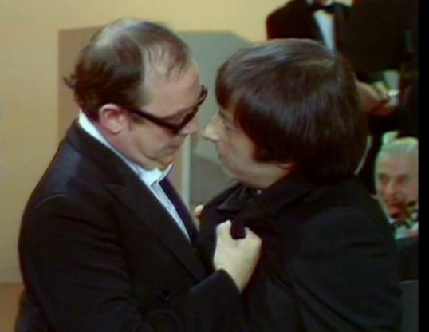
Art appreciation by tone-deaf scientists?
(More relevant appreciations …. Bach and Sagrada Familia etc …. or even - nobody expects … the right words in the right order?)

Slide 6
Science “and” Humanities [STE(Eng)M] < > [A&H/PPE(Econ)]
Engineering = (Human) ingenuity. Economics (the dismal science) = behavioural psychology whereas numbers = maths.
“Science”
& STEM
(Objective Stuff)
“Humanities”
& the Arts
(Subjective Stuff)

Slide 7
Science “and” Humanities [STE(Eng)M] < > [A&H/PPE(Econ)]
Human World / Natural & Built Environment (of Humanities & Engineering)
Rhetoric ?
Information Flows – ie Communications
Knowledge, Understanding, Reasoning, Decisions, Commitment ….
T
Logic ?
S
M
Metaphysics

Slide 8
Statements of the obvious?!?
Obviously! Science is an enormous good. That’s a given here? Obviously! It’s good to appreciate the humanities? (Yes, even post-modernist philosophy is worth appreciating!) Obviously! Not instead of science. (It’s as-well-as, mutual, a two-way-street)
NO! The important message (if not yet obvious): More than science isn’t simply more science with a side order of humanities. More than science is proper integration of science and humanities. Science and the humanities are (better seen to be) inextricably interlinked. Each adding value to the others processes of knowing & understanding etc. It’s about integrating the values & processes of science & humanities.
[ASIDE: The tweets & FB posts re Jack Ma talking at Davos couple of weeks ago? The more we can automate the scientific stuff, > NO less reason to understand the science stuff, > BUT the more important it is we understand the integration of the humanities stuff into our reasoning. > The focus needs to shift to better understanding of the humanities and its relationships with science rather than science content.]

Slide 9
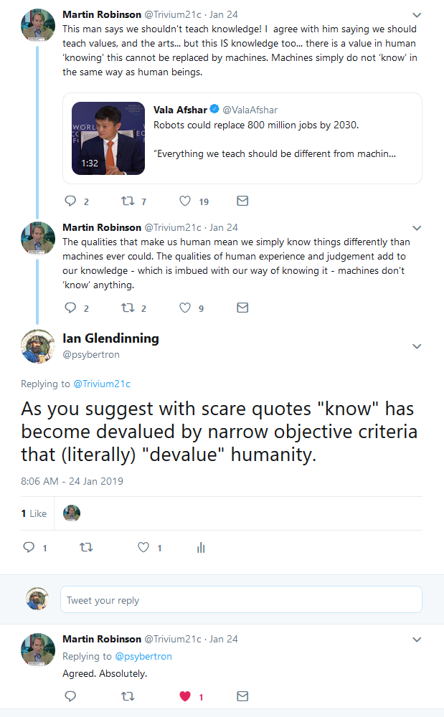
Clue: It’s not about the AI (AI can automate the objective content and logic stuff.)
More than science is proper integration of science and humanities.
It’s a shift of (educational) focus from the objective content to that integrated reasoning.

Slide 10
The post-enlightenment Romantics?
Careful with that knife Aristotle!
(Me, 9/11, 2001 h/t Pink Floyd)
Little by little we subtract,
Faith and fallacy from fact,
The illusory from the true,
And starve upon the residue.
(Hoffenstein, 1933)
“Sweet is the lore which nature brings;
Our meddling intellect
mishapes the beauteous forms of things;
— We murder to dissect.”
(Wordsworth, “The Tables Turned”, 1800)
The warnings are not new.

Slide 11
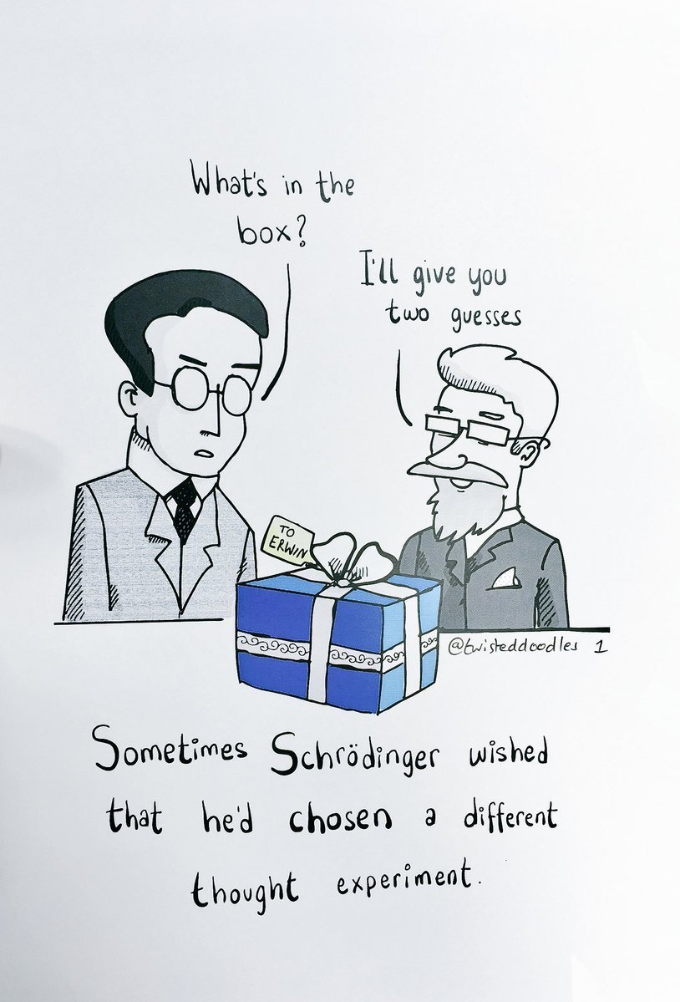
Maybe a 20thC Scientist?
He sees life as negative entropy or free energy (or information).
He sees the subject / object divide in scientific reality – and the Vedic Upanishads and Eastern “mystical” “holistic” views being much closer to the quantum world view!
He nevertheless draws on Spinoza, Descartes, Schopenauer, Kant et al.
He rails against a narrow Greek legacy in western culture, whilst still naturally defending its correct position in science itself.
Was Erwin Schrödinger “woo”? Read his “What is Life?” (1944) and “Mind & Matter” (1958) and decide for yourself.
Or try a 21st C Scientist, like Carlo Rovelli https://www.facebook.com/groups/215610305261879/permalink/1197475530408680/
#MeToo

Slide 12
Choice of words?
Communications …. Information flow, generally? (Used lots of words already.) Knowledge / Understanding / Reasoning / Decisions / Commitment ….? Argument / Disagreement …. ? Debate / Discussion / Dialogue …. ?
“Good” argument is Dialogue Proper, Constructive, Progressive Dialogue. Two (or more) parties communicating in good faith aiming for increased net knowledge & understanding.
Argument – only in the formal logical sense. [Proof & disproof only in scientific or forensic context. Fisticuffs and shouting-matches / directed-rhetoric / trading-insults (even ironic humour) you’ve either already failed or you’ve mutually agreed contact sport is fun (which is OK).] Debate – only when you’re in an artificial world. [Like a debating chamber or a court of law or a board-room … where it is pre-agreed that differences will be settled by a vote or an authoritative decision within that context.] Fact-check – sparingly – it’s a gimmick (especially in real-time social-media) [OK for main claims in formal contexts, but there’s much rhetoric in real interactions and timing is always after the communication. Hindsight, like scientific evidence in fact. Best social-media moderation is slowing down the processes – like a nuclear reactor - IMHO?]

Slide 13
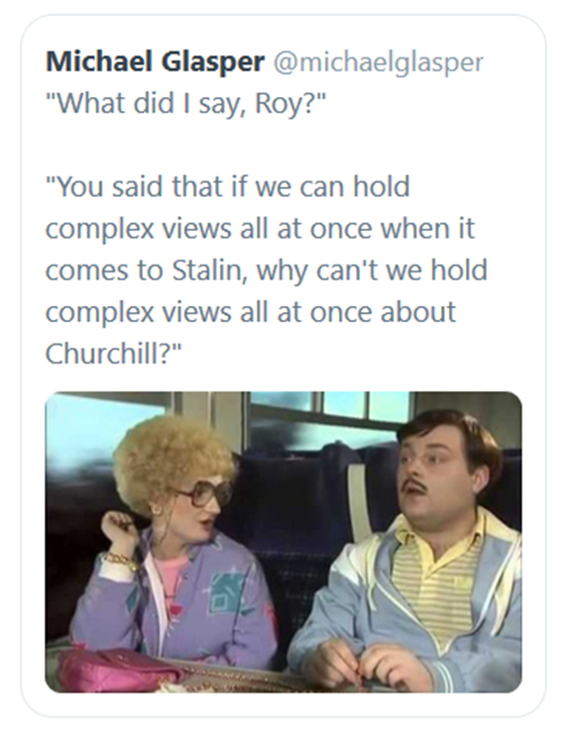
What did I say, Terry?
Good argument is proper dialogue
Proper dialogue involves integration of Science & Humanities, values and processes of reasoning.

Slide 14
So, what makes dialogue good & proper?
Rules of Engagement for “good dialogue”? Constructive / Progressive is more than scientific. Good is more than scientific. And, free-speech is not the only rule ;-)
Getting to first-base? Firstly, maybe worth checking we’re speaking the same language?

Slide 15
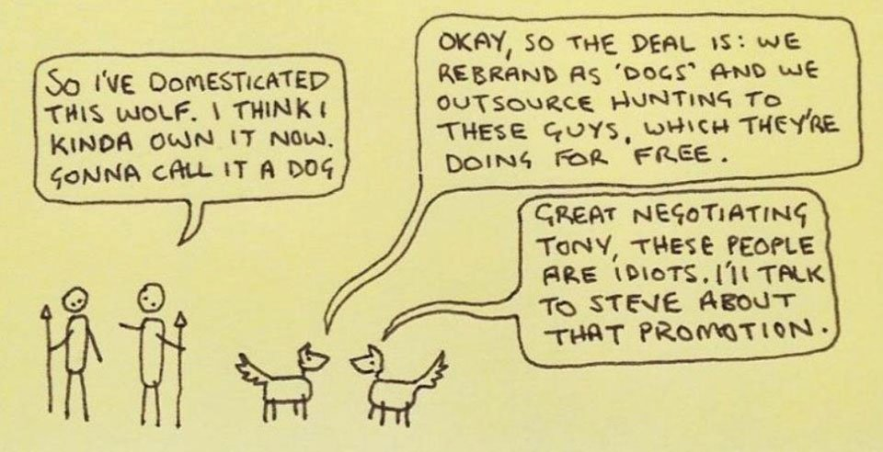
Two sides to every story. Are we speaking the same language?

Slide 16
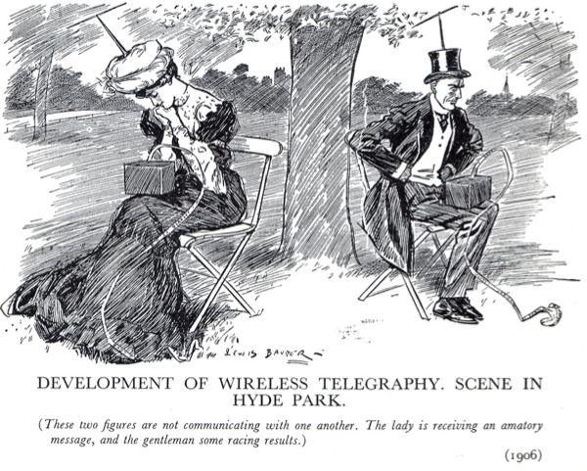
Are we even communicating?
“Communication is like a cat. You pull the tail at one end and it miaows at the other ... [however] … the real communication problem is the illusion that it has happened.”
Einstein (apocryphal?)

Slide 17
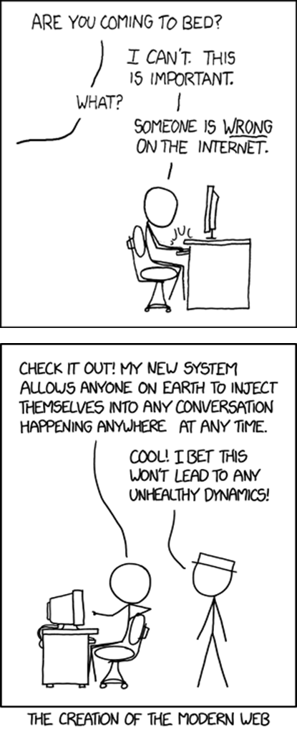
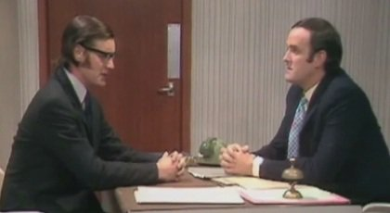
Have we committed enough time to have a proper dialogue?
As Bill Gates says (amongst others): “Busy is the new stupid”
Is this the right time & place to have a (good) argument?
h/t XKCD

Slide 18
Life’s too short. To waste too much time on “sub-optimal” dialogues.
Easy to find “irrational” stuff to be sceptical about. [No shortage of Gyneth Paltrows and Flat-Earthers and Anti-Vaxxers and assorted pseudo-science trolls to be sceptical about, even to be cynical and motivated by SJW-style outrage? And how often is it progressive, if and when you do engage?]
Much harder to be sceptical about science and rationality itself. [Meta, remember – about the processes and values of science we take for granted – not the content which is necessarily contingent and potentially skewed by interests & biases. We have “critical thinking” and “scientific method” (etc) for that.]
“We [do these things] not because they are easy, but because they are hard.” (JFK)

Slide 19
“I think what post-modernists did was truly evil.”
“I think what physicists did was truly evil.” Both equally irrational statements
But, but, but …… NUANCE matters!
“There’s a crack, a crack in everything, it’s how the light gets in.” (Leonard Cohen)

Slide 20
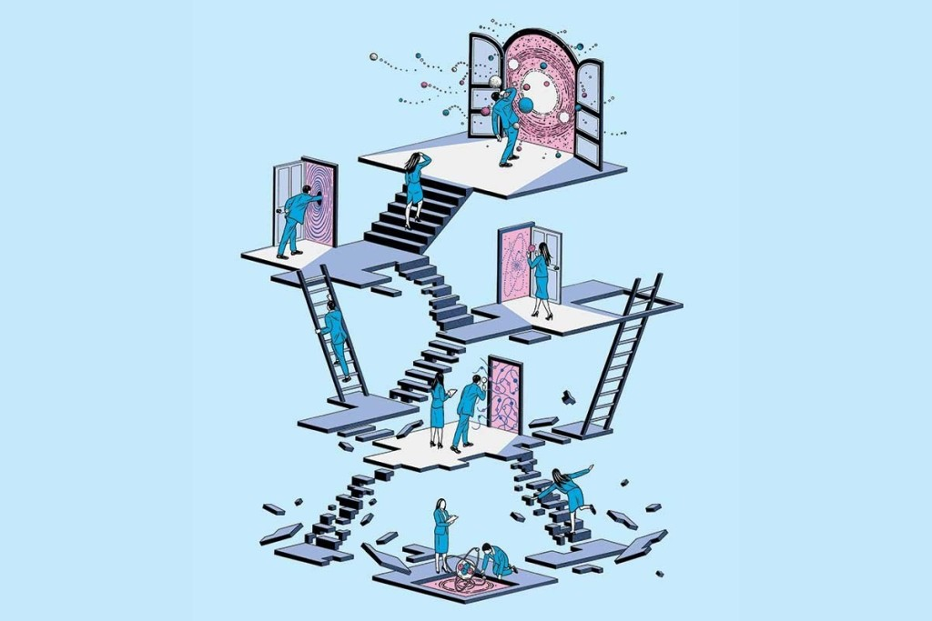
Time Check?
Endless Rules and Examples?
Summary
Clarification & Discussion
(Getting to first base, … first, obviously.)

Slide 21
Rules of “Proper Dialogue”
Cf - Logic < > “Rules of Rhetorical Engagement” Rules are for guidance of the wise and the enslavement of fools.
Freedom of expression – comes with rules and constraints.
In a sense only 3 rules: Respect, Respect and Respect.
Respect = Good faith – not just good intentions, but taking responsibility for follow-through (offense, misunderstanding, getting to first-base, agreeing to disagree as a minimum, etc.)
Getting to First-base / Rappaport’s Rule / aka “Steelmanning” >>(more)
Agreeing to Disagree / Pause or Complete Stop. >>(more)
Many wrinkles (subjective rules and exceptions that matter even though they can’t be comprehensively and objectively defined):
“Definitions” – broad and narrow, fixed and fluid.
“The Court Jester” – irony and humour generally.
“Good fences” – rules that “look” PC or PoMo but need to understand where and why they matter.
“Game theory” – whether win-lose or win-win, strategic attention-grabbing, devils advocate, ironic lies and deliberate offense, playing to the gallery, and more “tricks of sophistry”. NOT advocating sophistry, but communication is ALWAYS a rhetorical game.
(See http://www.psybertron.org/rules-of-rhetorical-engagement )

Slide 22
Two Key Process Rules …
Getting to First-base? (Rappaport’s Rule or “Steelmanning”) The opposite of a straw-man. Re-stating the other position so well and succinctly, that the other not only agrees but thanks you for doing it better than they could themselves, whether you agree with it or not. (Cf straw-man, mis-representation of other position - explicit or implied, deliberate or accidental.)
Agreeing to Disagree? (Whether pause or complete stop.) Did we or didn’t we get to first-base? If not is there any earlier statement we can agree on? (Even if it’s a statement of what it is we’re not agreeing or even sharing an understanding.) If neither – we’re still at square-one – we have failed to reach first-base. Have we agreed it’s worth putting more time into this?

Slide 23
What did I say? (Have we even got to first base this evening?)
“We benefit from a proper integration of science and humanities approaches to knowledge and reasoning.” ====
“Good Argument = Proper Dialogue using integrated reasoning.” ==== “Proper Dialogue has rules that matter. (even if they’re rhetorical / subjective / PC / PoMo).” ====
“Getting to first-base / on the same page is a key process rule.”

Slide 24
Questions?
If we haven’t got to first-base clarify / repeat as necessary?
Why? (How come and what for?) Why is simply “more science” bad news? Why is it detrimental to better integration? Why does that matter?
Facts / Right & Wrong / Truth & Good / Error & Lies? (Virtues? We tend to remember Aristotle for his logic in “western rationality”, overlooking the whole package of Ethics and Poetics.)
Winning? (Shredding / Destroying / “pwning” / Dismantling, etc.) X
Human Exceptionalism?
Actual Metaphysics?

Slide 26
END

