Slide 1
https://eem.institute/
Contemporary Systems Engineering
Anatoly Levenchuk Head of Science, EEM Institute
Director for research, INCOSE RUS
31-oct-2022

Slide 2
Engineering is a practice of changing physical world to the better.
What is «better for the world»? Variants:
Ethical answers. Ethic is a science about «what is goodness, what is wickednessl, what is better actions that lead for better world»
Technoevolutionary improvement: multi-level evolutionary continuous quasi-optimizations that reflect frustrations from conflicts between system levels. Actions to minimize the free energy, according to the theory of active inference, minimizing unpleasant «surprises» for agents

Slide 3
Fundamental thinking practices Intelligence Stack: practices of augmented intelligence
Intelligence Stack (fundamental, scale-free, transdisciplinary practices)
Applied Practices (engineering of specific scales and types of systems)
specialization for complexity levels
Systems Engineering
Methodology
Rhetoric
Ethics
Aesthetics
Research
Rationality
Logics
Algorithmics
Ontology
Theory of Concepts
Physics
Mathematics
Semantics
Self-collectedness
Conceptualization
Systems level | Applied Engineering
Humankind | So far, there are none.
Society | Normative politics, economics
Community | Cultural development (normative sociology, anthropology)
Organization | Enterprise engineering (operation = operational management)
Person | Psychotherapy, education (based on cognitive science)
Creatures | Genetic engineering, medicine, agriculture, ...
Cyber-physical systems | Classical systems engineering
Substance | Chemical synthesis, engineering of hardvare

Slide 4
Trade-off: teach to SoTA or "like everywhere else"? Chosen: teach to SoTA. Pros: We train the elite. Cons: withstand the criticism of the bulk of the peloton.
We will not learn "as everywhere else"
We're here
Guess/hypothesis: take SoTA (continuous) software engineering, cyber-physical systems engineering and enterprise engineering, generalize it all for all types of systems (scaleless and continuous systems engineering) – and teach it on a base of full intelligence stack.

Slide 5
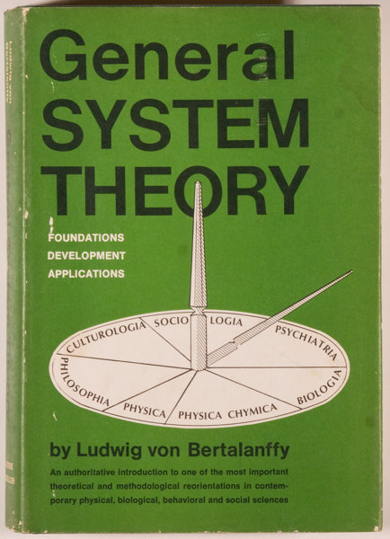
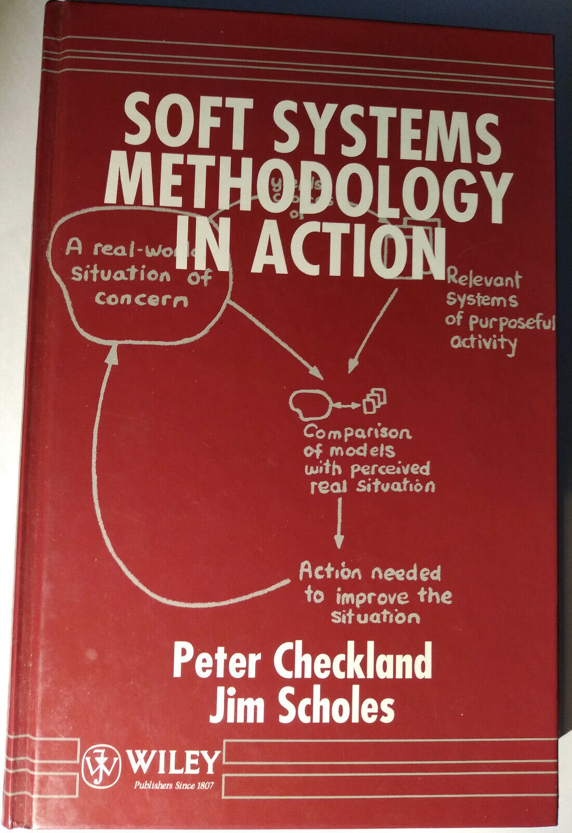
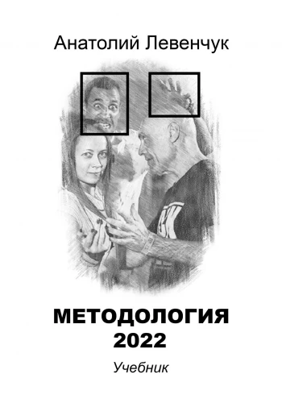
Three generations of the systems approach
The target system in its environment, various descriptions, the concept of the system and the architecture (operating time, "system processes" - operation processes). - Ludwig von Bertalanffy, Austrian biologist «Neither a life, nor a cycle», the system is created by other systems: the constructor (project team) and its engineering practices, external project roles. Peter Chekland, mid-80s. The system is not created, but evolve is not a technoorganism, but a techno-view in the course of technoevolution (the meme is stored separately), competing with other species. Continuous delivery. People from ThoughtWorks, Eric Rees, Vanchurin-Katznelson, etc. (references to the literature are collected in our textbooks)
1940-1968 (compilation)
1972-1981 (compilation)
Literature since around 2011

Slide 6
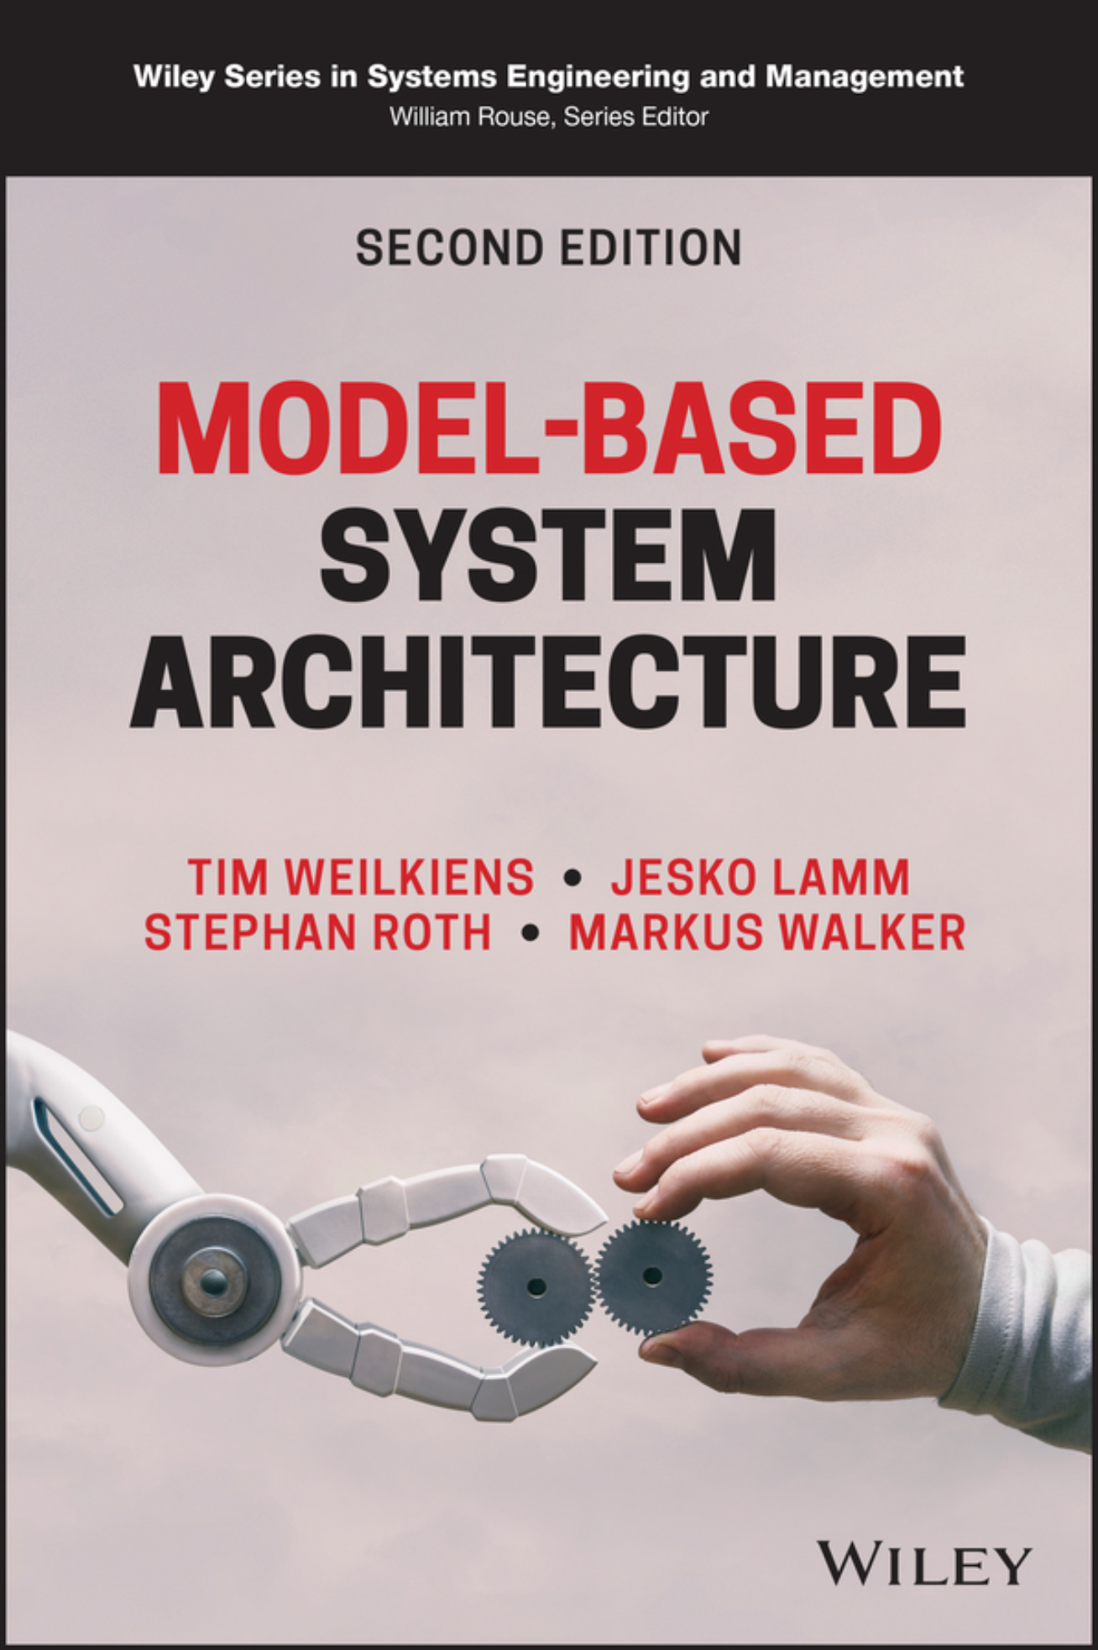
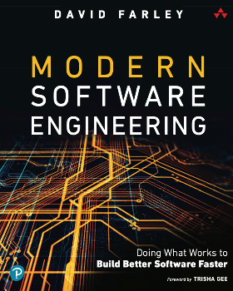
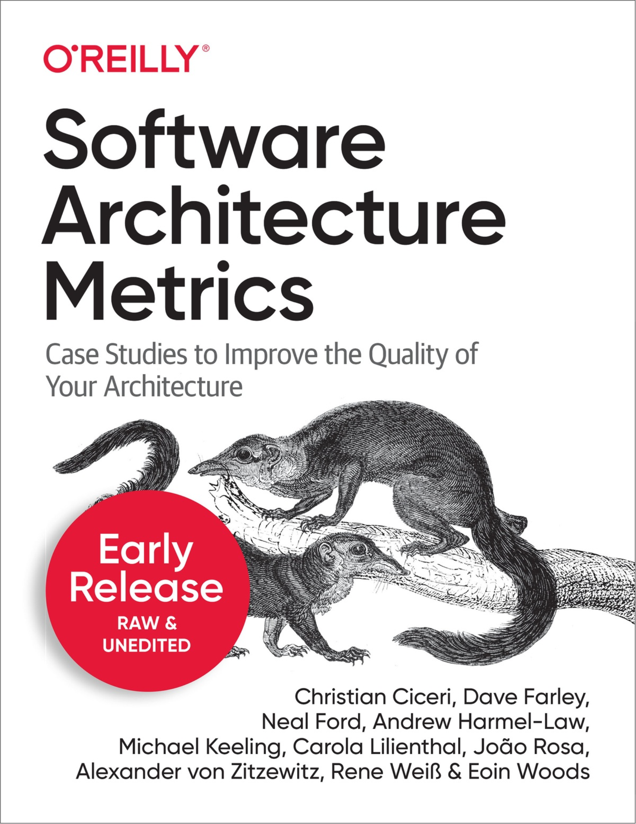
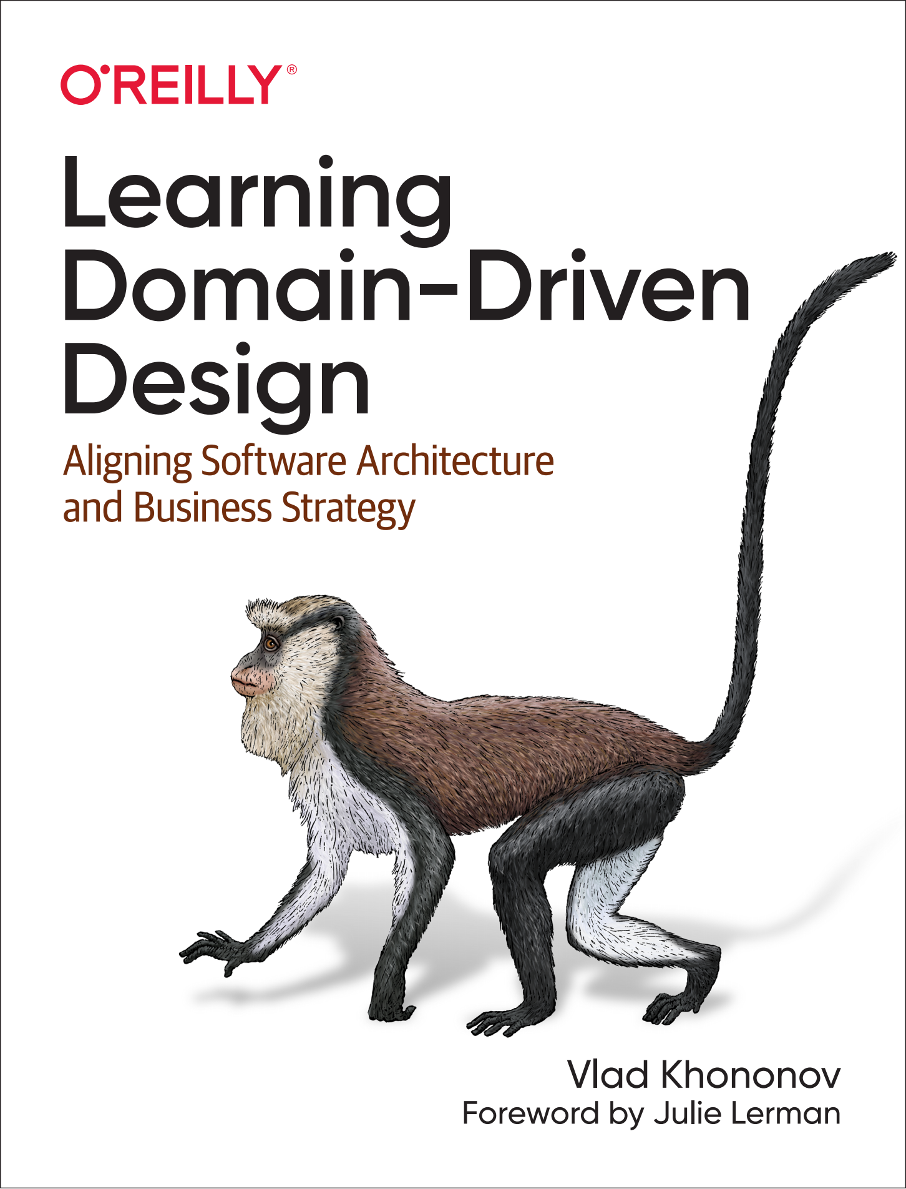
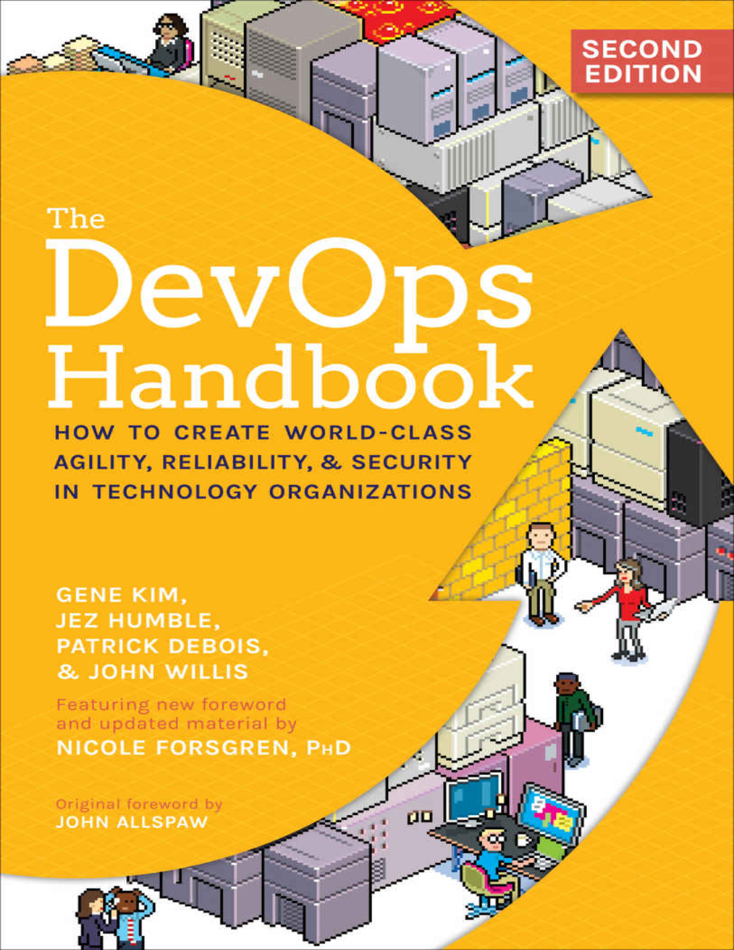
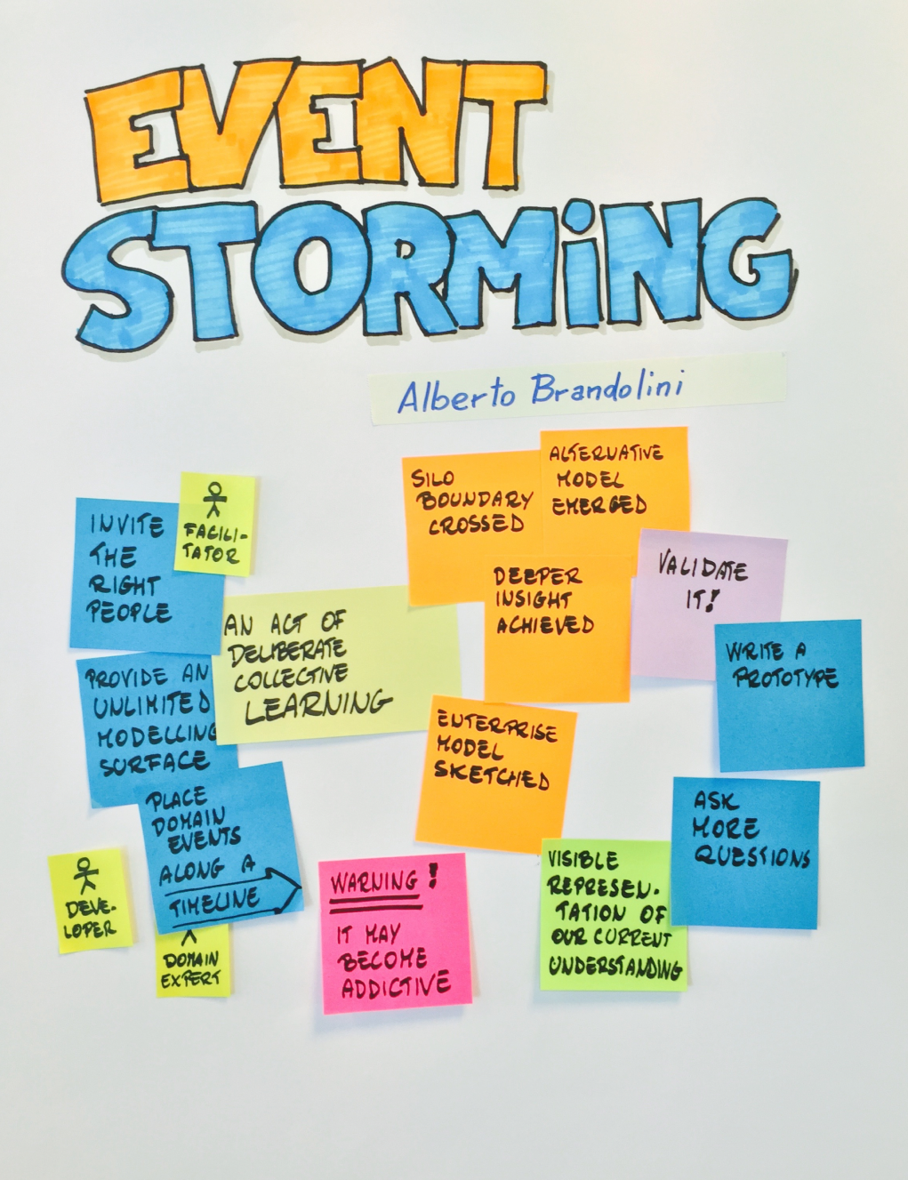
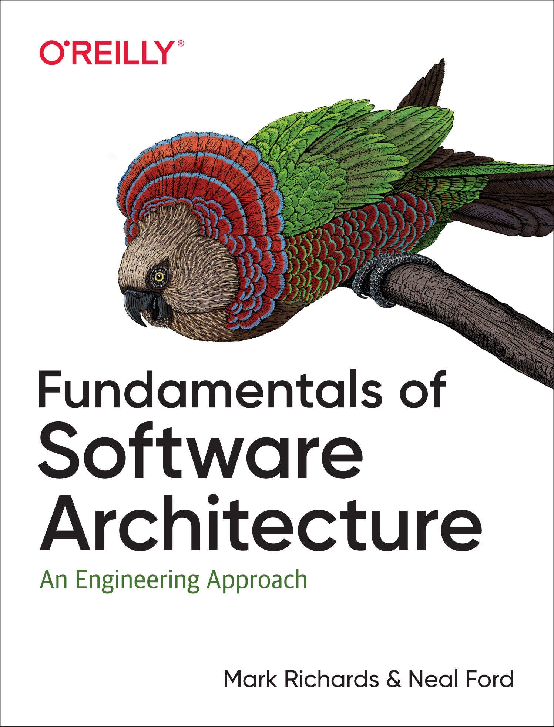
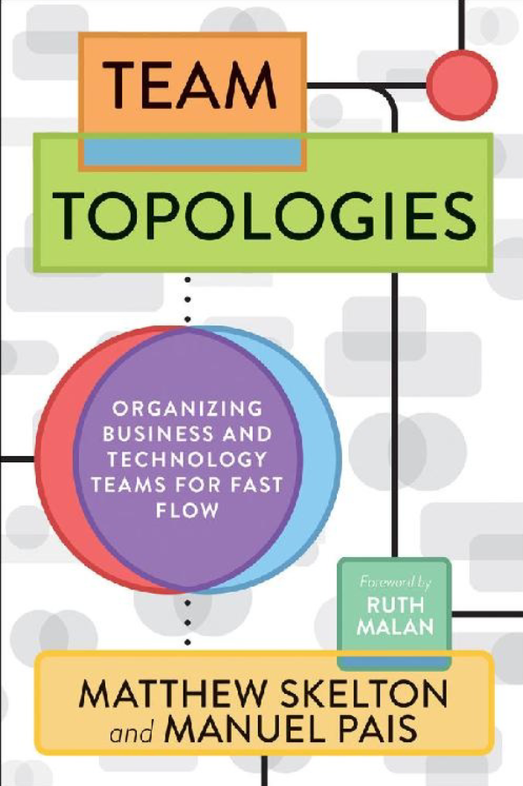
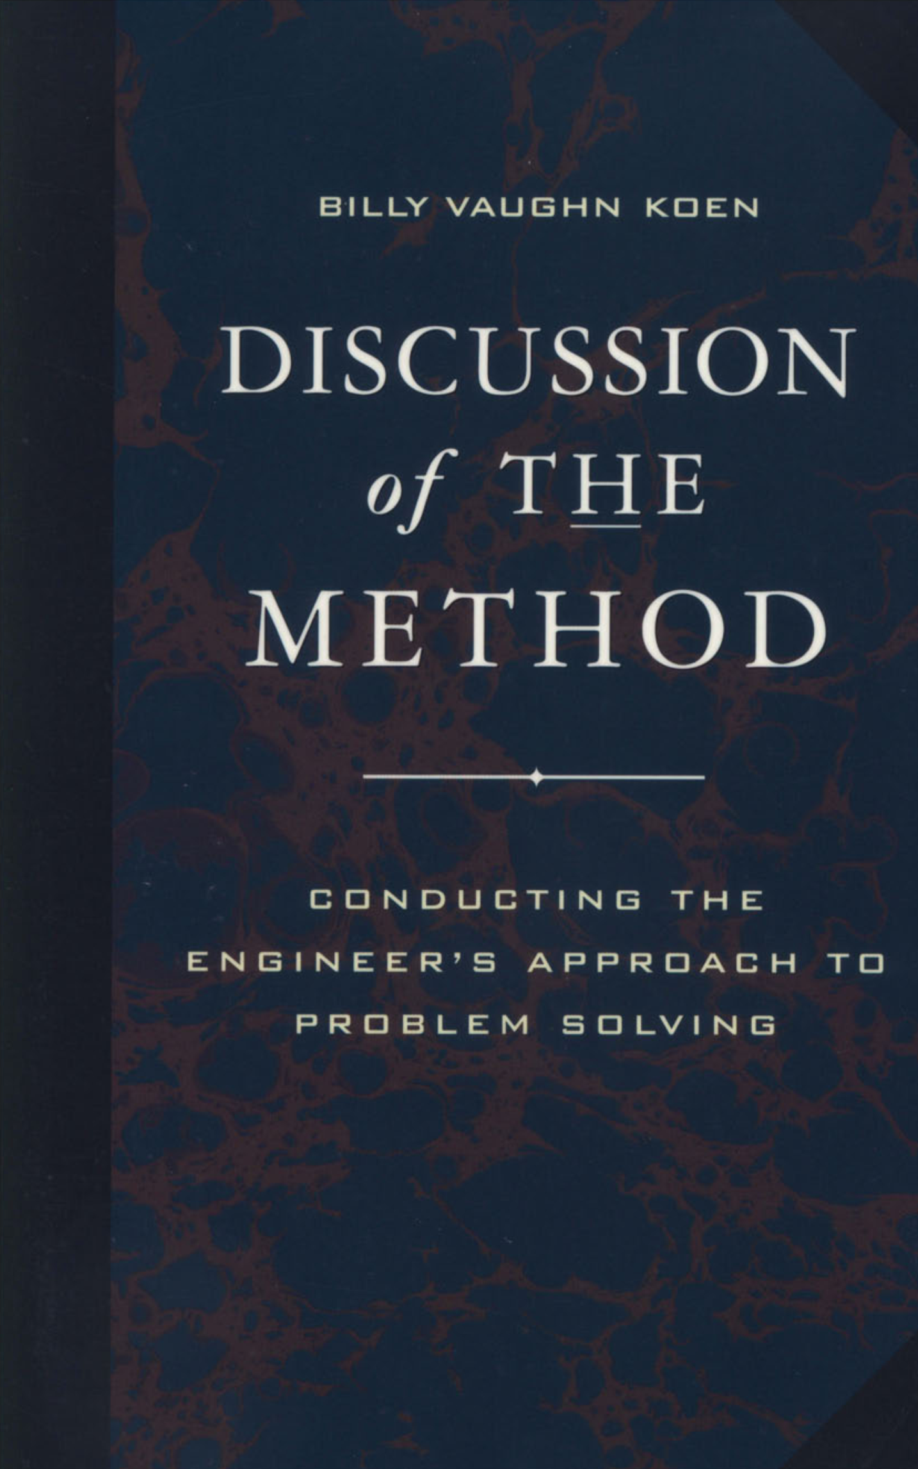
Literature in the «Systems Engineering» course (SoTA 20 textbooks, and 167 more footnotes)
2022
2022
2022
2022
2022
2021
2021
2020
2020
2019
2017
2017
2016
2015
2014
2011
2011
2009
2003

Slide 7
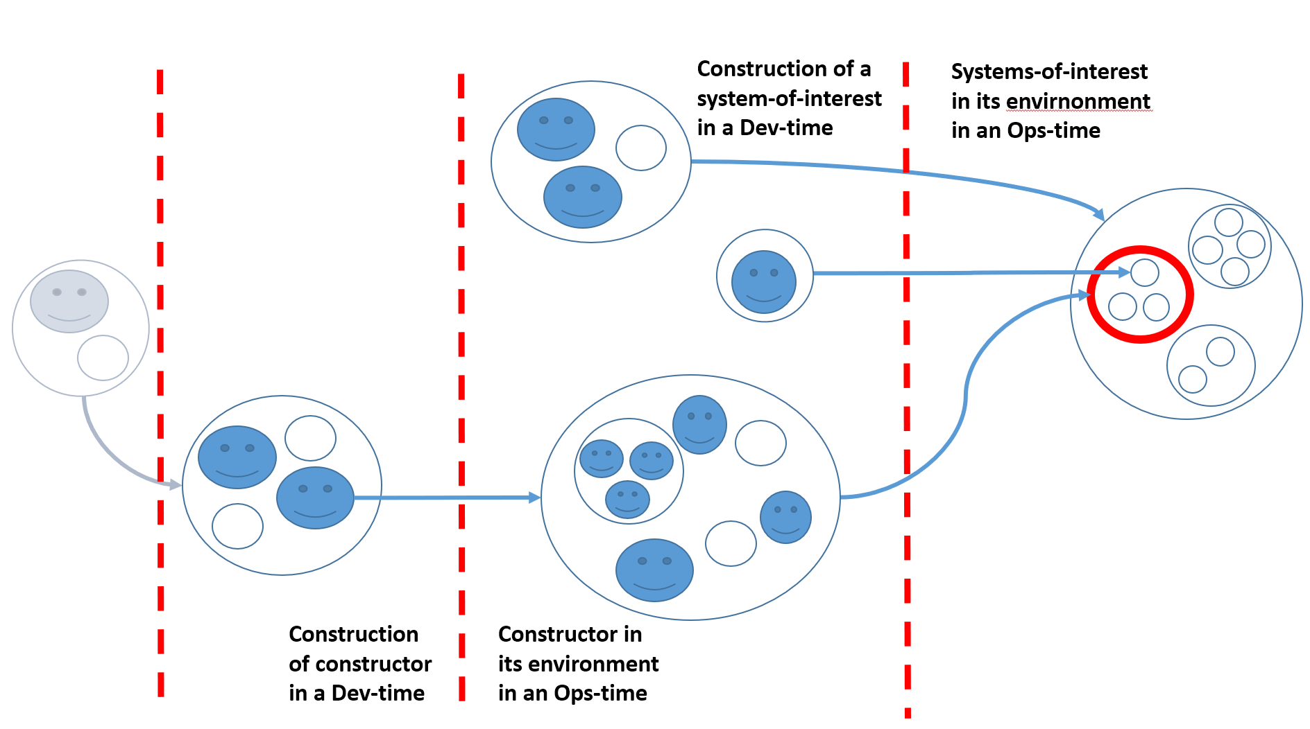
Essence of SoTA Systems Thinking
Memome here
Phenome here
Memome here
Phenome here

Slide 8
Test for the presence of systems thinking
Systematic is not systemic System thinking is the use of the concepts of systems approach for conceptual attention aiming and locking at important objects in activity / practice / labour / engineering. If there are system levels (suprasystem-system-subsystem) used in reasoning, then systems thinking at presence. If not, then it's reductionism or holism: ignoring emergence or the inevitable conflicts that lead to frustrations. An example where there is no systems thinking: "A building is made of bricks": truth, but useless truth. The building is conveniently considered to consist of walls, not bricks. And the walls are made of bricks, one more system level.

Slide 9
System Layers and Scalelessness
Population
Organism
Organ
Cell
Molecule
Came from physics (system and environment, emergent properties of system that consist of interacting parts) Watch emergence and increased complexity in each level – hooray, it works! (Bertalanffy) Self-organization and self-maintenance in biology and psychology -- autopoesis (Varela, Maturana) Multilevel Evolution and increase of complexity as a physical process (Vanchurin, Katznelson, Fields, Levin), scale-free description of complex systems
Evolutionary levels
Humankind
Society
Community
Organization
Person
Creature
Cyber-physical systems
Substance

Slide 10
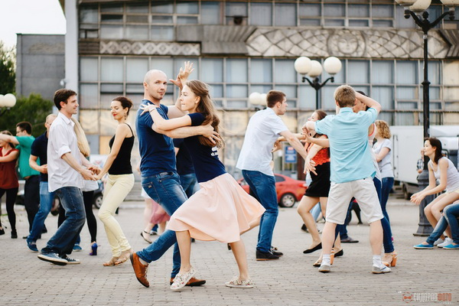
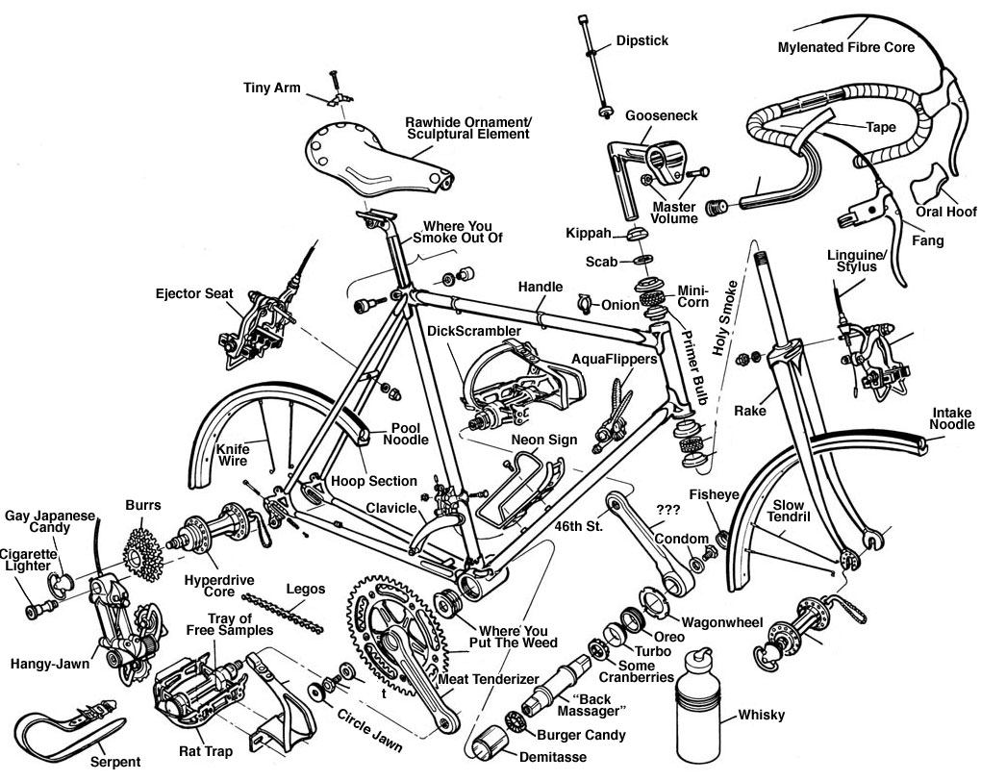
System levels selects by attention, not physically!
What you see here in a dance as a dynamic object?!
Not disassemble but select objects in construction (Dev-Time) decomposition by you attention.
Functional systems view of Ops-Time
Construction/module view of Dev-Time. This is affordances for Ops-Time. Completely another viewpoint.
At the enterprise: everything is the same, but "dance“ together hundreds and thousands of people with a variety of things. Use your attention and 4D extensional ontology (with spatiotemporal parts)

Slide 11
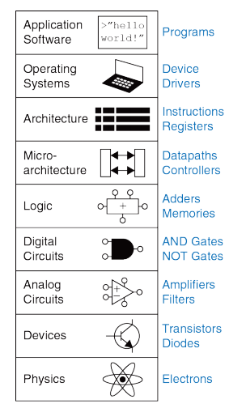
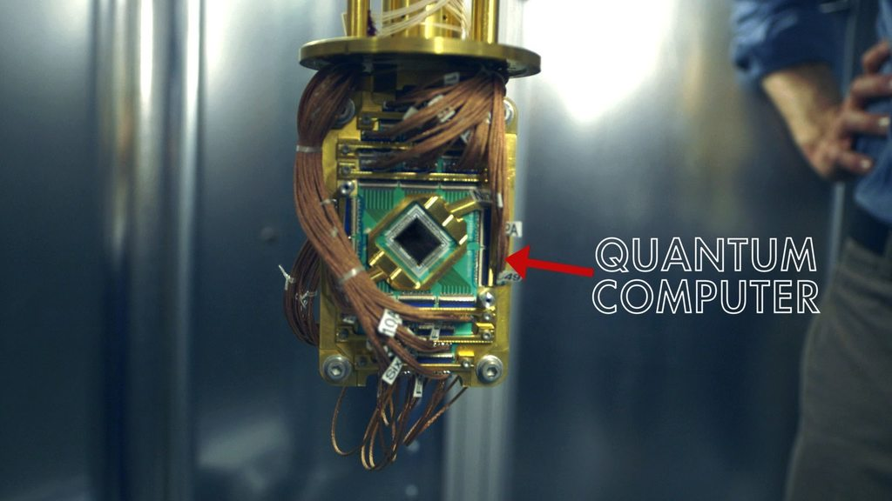
Disruption – from the lower (platform) system layers, not from the upper application layer!
Demand $$$
Disruprion
And this is also curriculum plan for engineers/constructors (to know the practices of your level-of-interest and two neighboring ones)

Slide 12
MBSE: no need for a term. Simply «Engineering»
2018 Boeing MBE diamond diagram
[now: for MVP than increments, no life cycle]
Non-systems engineering already not exist
Non-model-based engineering already not exist (but not with SysML language!)
Life cycle vanished as viable concept (continuous everything: only MVP and increments, all guesses, not requirements)
No retirement phase (continuous everything)
Digital twins, digital thread, digital engineering – modeling reaches operations
AI will disrupt all of this

Slide 13
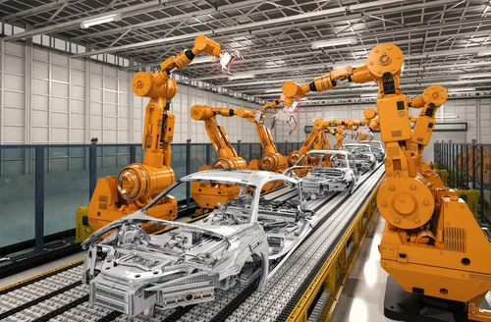
Roles in (systems) engineering
You build it, you run it!
User
Product owner/visionary (busine$$ case)
Platform engineer

Slide 14
Systems Engineering Practices and Roles (and its Systems Management specializations)
Systems Engineering – systems engineers:
Development – developer and operations engineer: you build it, you run it!)
Concept (busine$$ case) development – visionary/strategist/product owner
Architecturing – architecture
DevOps/platform engineering – DevOps/internal development platform engineer (no performers: automatic plant)
Systems Management – systems managers:
Organisation development – organizer (orgdesigner, leader) and operations manager
Business (inve$tment case) – businessman/founder/entrepreneur
Org architecturing – org architect
Administering (HR, finance, procurement, …) – administrator (both organizer of administration-as-an-internal-orgplatform and performer in it)

Slide 15
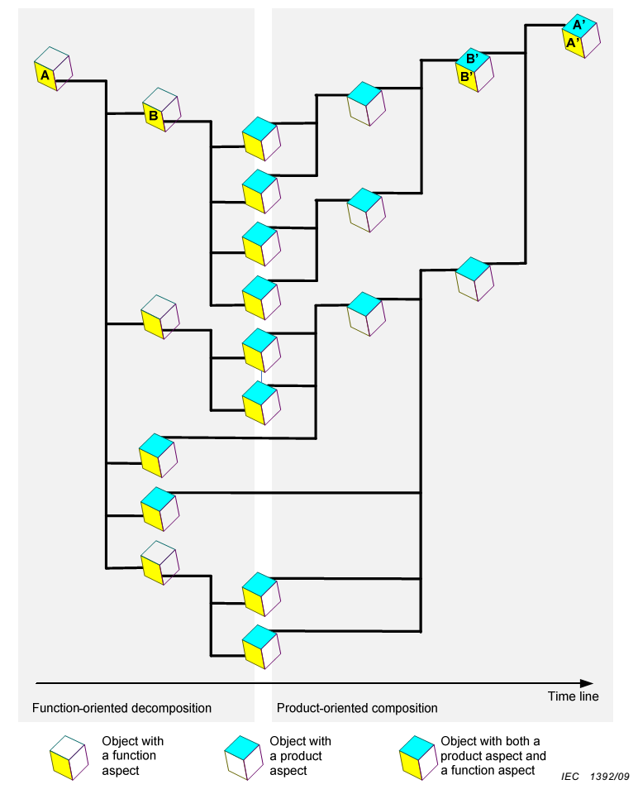
Operations concept, Systems concept, Architecture in system definition
Architecture (module and connectivity decisions for architectural concerns/ilities)
Operations concept. Use cases and unit tests as a description of the functionality of a black box + business case
System concept. Transparent Box Affordances for Achieving Black Box Functions
Visionary (business case)
From IEC 81346-1

Slide 16
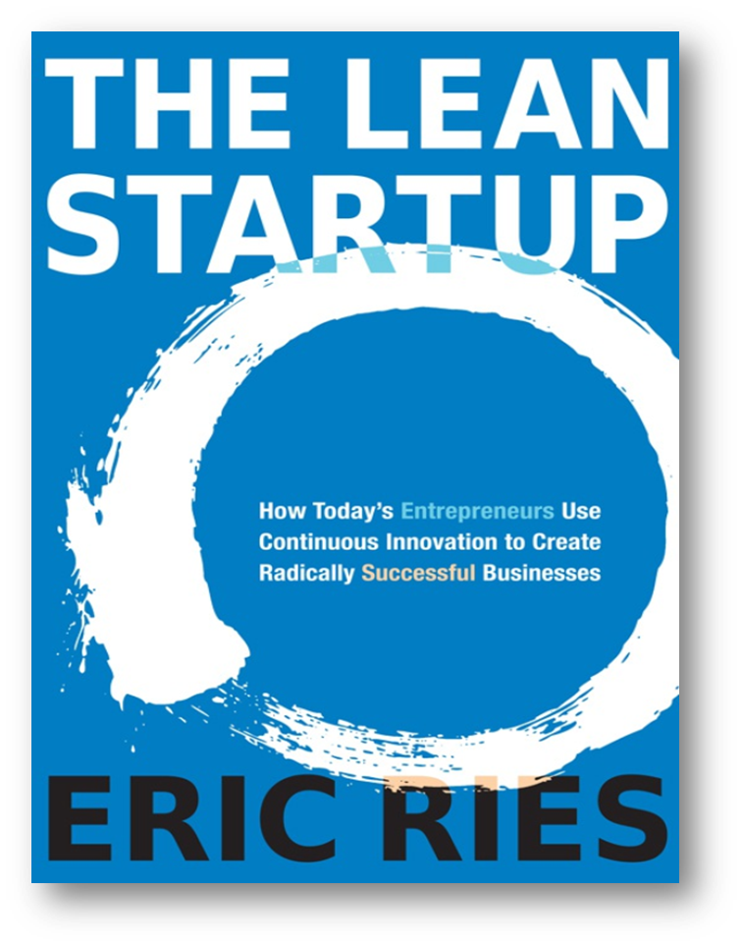
Entrepreneurship and absence of requirements (deontic→doxatic and continuous everything)
Entrepreneurship is a guesses/inventions about affordances (module synthesis) in suprasystem. Objectives: active/embodied inference, reduce negative surprise (no reward function, but there is a function to prevent loss. "The action comes from dissatisfaction, possibly predicted" -- as in Ludwig von Mises praxeology) Theories and products are similar in terms of obtaining them (guesses and tests, the survivor wins after checks). Continuous development: it will not work from the first time (market/entrepreneurial hypotheses and experiments), and it is impossible to finish (continuous development/delivering/evolving) Most solutions are about equally useful, although they differ (frustrations and quasyoptimality) «Engineering of systems» should support all this similar to a «science of theories».
2011
All organizations are startups → all activities are entrepreneurial

Slide 17
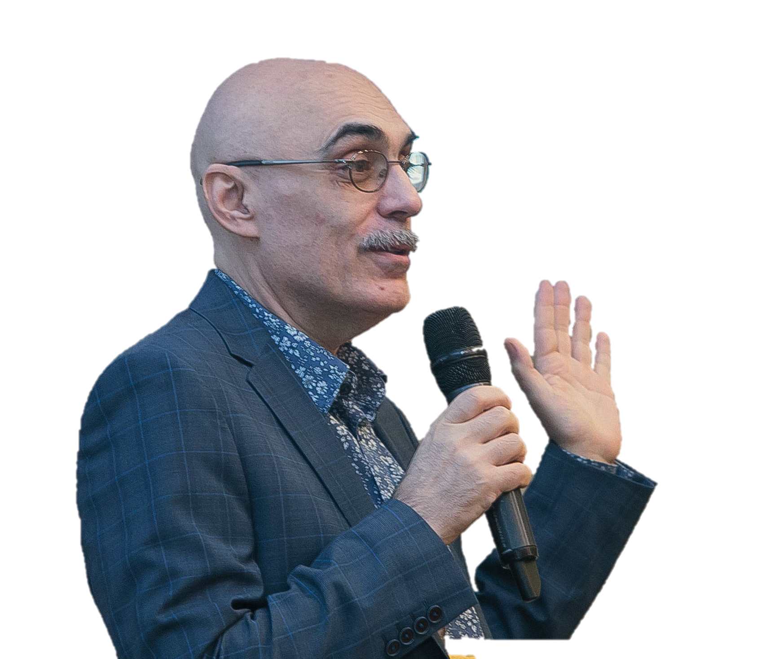
Thank you for your attention
Anatoly Levenchuk
https://www.linkedin.com/in/ailev/

