Slide 1
Open-endedness curriculum at EEM Institute
Anatoly Levenchuk Head of Science, EEM Institute
5-oct-2022

Slide 2
Engineering is a practice of changing physical world to the better.
What is «better for the world»? Variants:
Ethical answers. Ethic is a science about «what is goodness, what is wickednessl, what is better actions that lead for better world»
Technoevolutionary improvement: multi-level evolutionary continuous quasi-optimizations that reflect frustrations from conflicts between system levels. Actions to minimize the free energy, according to the theory of active inference, minimizing their unpleasant "surprises"

Slide 3
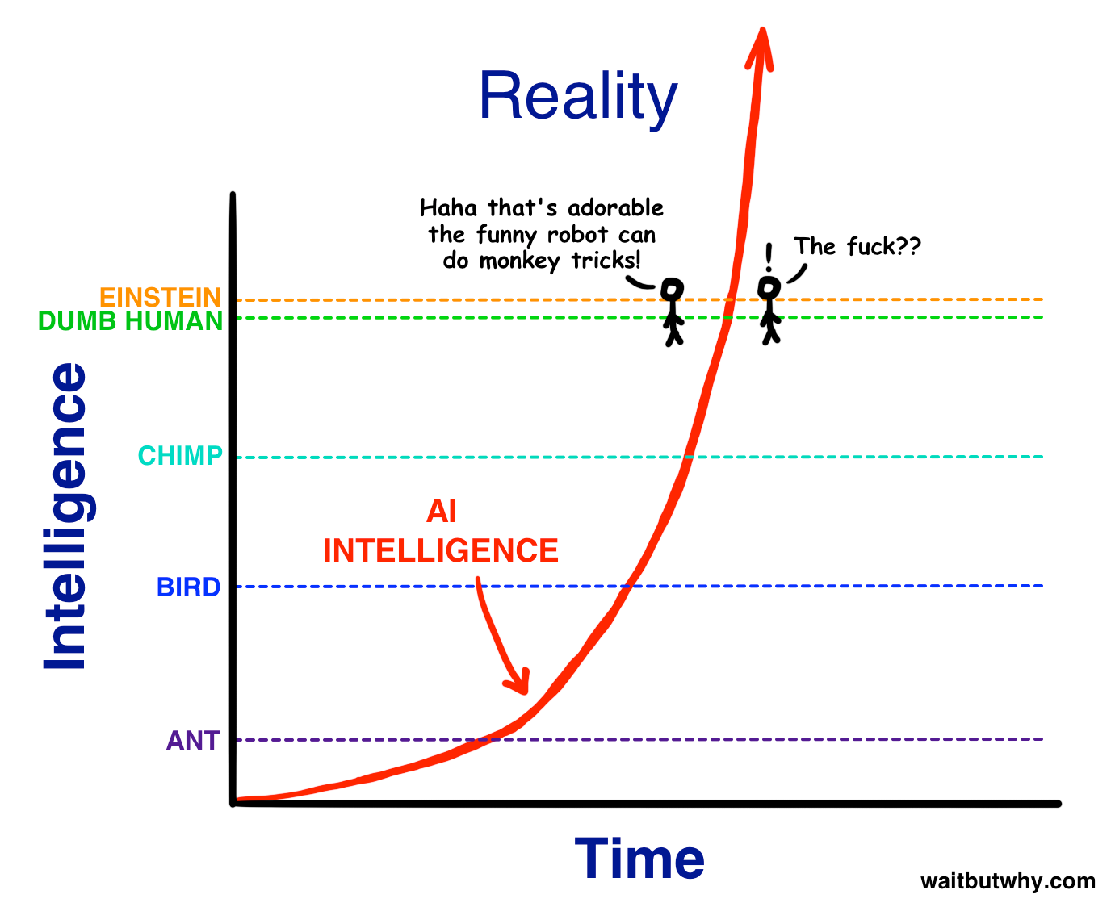
Singularity
Vernor Vinge (January 1983, popularization of I.J.Good's thesis 1965):
Thirty years before the creation of artificial intelligence [2013, modern assessment from "very soon" to "in a couple of decades"] Artificial intelligence will apply its intelligence to augment itself. Very soon after that, man will cease to be the king of nature (as primates are now). It is impossible to predict what will happen after that, but the world will change at such a speed that the common man will not be able to deal with it (sombody say, "already here").

Slide 4
Cyborgs as agent with augmented intelligence: -- cybernetic organisms -- cybernetic organizations Exocortex, exobody – this is «cyber». It works even without automation or AI. It as simple as "electronic flipchart". Cyborg provides control of multi-camera attention to the important things first, predictions (generative explanable models of the world – AI and more simple computations) second.
Standard model of consciousness (Graziano) Integrated Information Theory of Consciousness, IIT (Tononi)
Self-collectedness as a consciousness that deal with attention control (aiming and locking on the typed object)
Consciousness as in panpsychism with minimal phisicalism
Scaleless in system kinds (cyber-physical, personal. collective, social) – due to scaleless model of consciousness and attention
Scaleless in time – on spot, in inference, in a project, in lifetime
Supported by computers, no hope for biology here
Operations are discussed separately (inferences in the exocortex: calculations in AI systems, not in the human brain) Actions in the world (machines, robots, exobody) are discussed separately

Slide 5
How to save the world (from entropy)?! Continue the Enlightenment!
1. Understand how the open-ended evolition and thechnoevolution works. What are ways to speed it up by choosing a more efficient algorithm with smart mutations? 2. Enhance the intelligence of individuals by teaching people to thinking skills («intelligence stack» of thinking practices). This also applies to computers/AI, the intelligence stack is necessary for any intelligence, not just human intelligence! 3. Strengthen the intelligence of individual computer programs (develop more universal AI), and not only develop more effective algorithms, but also increase the computer power available to these algorithms. Develop robotics: enhance the possibilities of embodied action. 4. Develop distributed collective thinking and action (personal and corporate networks of computers/robots and people, and then these will be «networks of networks») 5. To ensure the proper level of physicality (embodiment), both natural and machine (both the development of body control in humans and the use of robots - the joint inclusion of bodies and robots of the network). Change the world, not only think about it!

Slide 6
Fundamental thinking practices Intelligence Stack: practices of augmented intelligence
Intelligence Stack (fundamental, scale-free, transdisciplinary practices)
Applied Practices (engineering of specific scales and types of systems)
specialization for complexity levels
Systems Engineering
Methodology
Rhetoric
Ethics
Aesthetics
Research
Rationality
Logics
Algorithmics
Ontology
Theory of Concepts
Physics
Mathematics
Semantics
Self-collectedness
Conceptualization
Systems level | Applied Engineering
Humankind | So far, there are none.
Society | Normative politics, economics
Community | Cultural development (normative sociology, anthropology)
Organization | Enterprise engineering (operation = operational management)
Person | Psychotherapy, education (based on cognitive science)
Creatures | Genetic engineering, medicine, agriculture, ...
Cyber-physical systems | Classical systems engineering
Substance | Chemical synthesis, engineering of hardvare

Slide 7
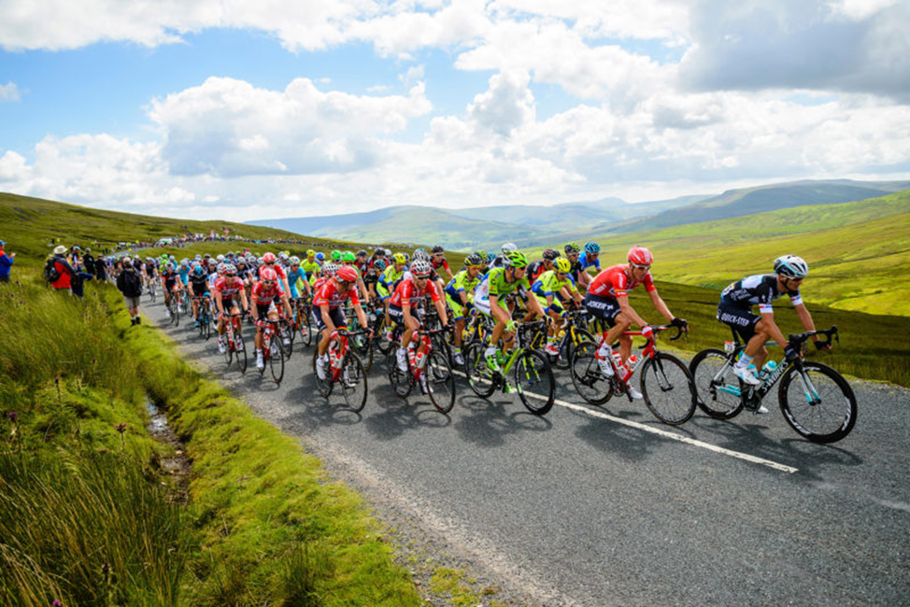
Trade-off: teach to SoTA or "like everywhere else"? Chosen: teach to SoTA. Pros: We train the elite. Cons: withstand the criticism of the bulk of the peloton.
We will not learn "as everywhere else"
We're here
Guess/hypothesis: take SoTA (continuous) software engineering, cyber-physical systems engineering and enterprise engineering, generalize it all for all types of systems (scaleless and continuous systems engineering) – and teach it on a base of full intelligence stack.

Slide 8
Architectural decision for courses (October 2022, draft)
Main courses Fundamental thinking practices | Ontologics and Communication | Self-collectedness | Practical Systems Thinking | Methodology | Systems Engineering | Education for the educated
Systems Engineering |  |  | + | + | + | +
Methodology |  |  |  | + |  | +
Rhetoric | + |  |  |  |  | +
Ethics |  |  | + |  |  | +
Aesthetics |  |  |  |  |  | +
Research |  |  |  |  |  | +
Rationality | + |  |  |  |  | +
Logics | + |  |  |  |  | +
Algorithmics |  |  |  |  |  | +
Ontology | + | + | + | + |  | +
Theory of Concepts | + | + | + |  |  | +
Physics |  |  |  |  |  | +
Mathematics |  |  |  |  |  | +
Semantics | + |  | + |  |  | +
Self-collectedness |  | + |  |  |  | +
Conceptualization |  |  |  |  |  | +
Applied courses Systems complexity levels | Systemic self-development | Systemic Fitness and General Movement | System Management | Mastery to teach the educated | Robots (Engineering of Cyber-Physical Systems) | System multidance
Humankind
Society
Community
Organization |  |  | +
Person | + | + |  | + |  | +
Creature
Cyber-physical systems |  |  |  |  | +
Substance
Preparatory and training courses are not shown

Slide 9
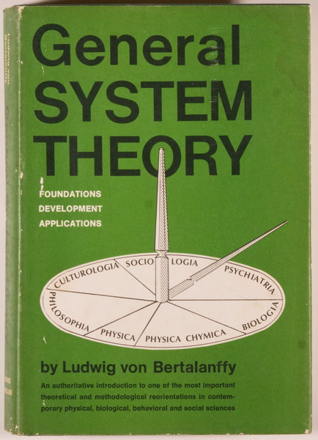
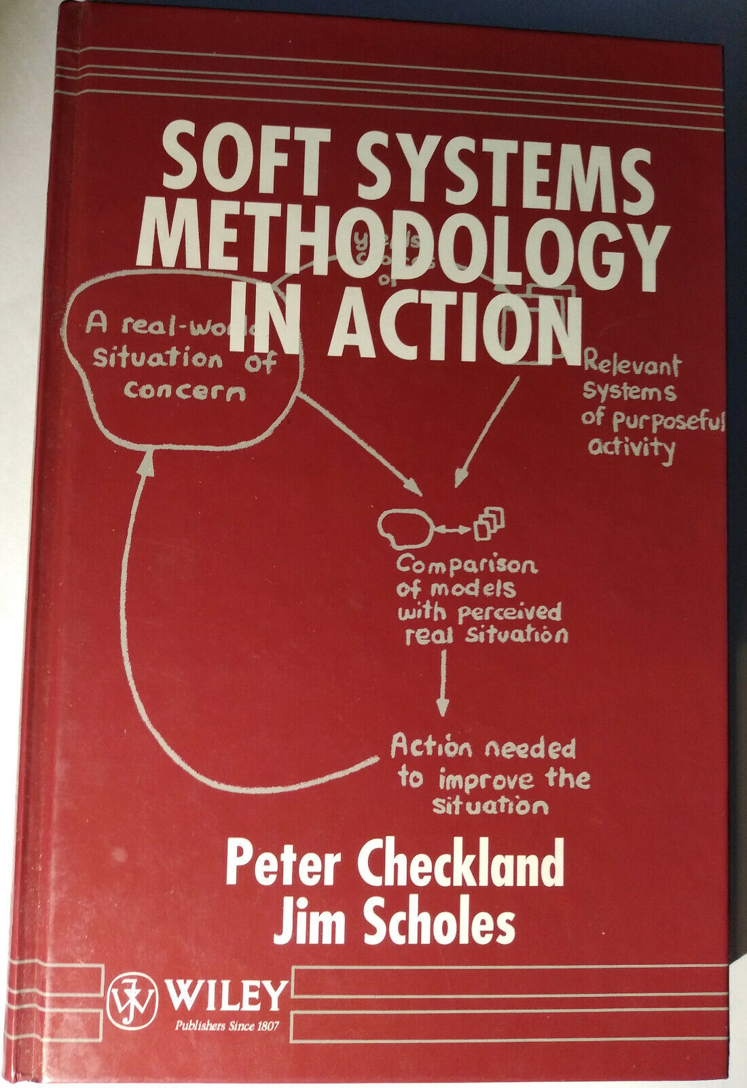
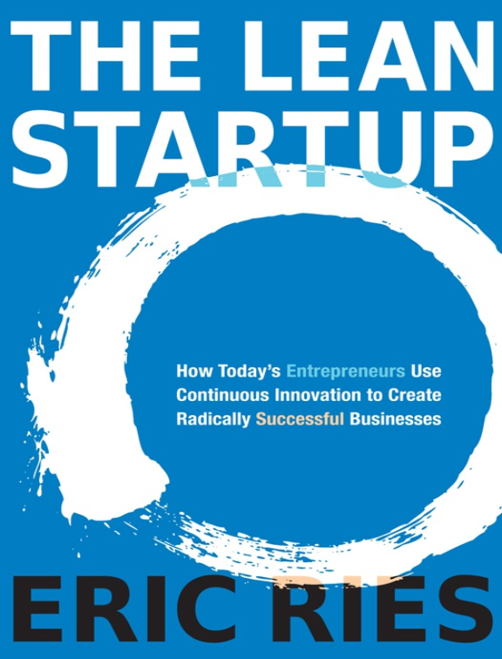
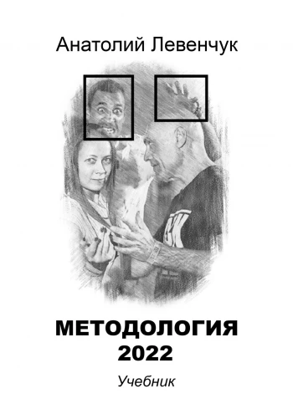
Three generations of the systems approach
The target system in its environment, various descriptions, the concept of the system and the architecture (operating time, "system processes" - operation processes). - Ludwig von Bertalanffy, Austrian biologist «Neither a life, nor a cycle», the system is created by other systems: the constructor (project team) and its engineering practices, external project roles. Peter Chekland, mid-80s. The system is not created, but evolve is not a technoorganism, but a techno-view in the course of technoevolution (the meme is stored separately), competing with other species. Continuous delivery. People from Thoughtworks, Eric Rees, Vanchurin-Katznelson, etc. (references to the literature are collected in our textbooks)
1940-1968 (compilation)
1972-1981 (compilation)
Literature since around 2011

Slide 10
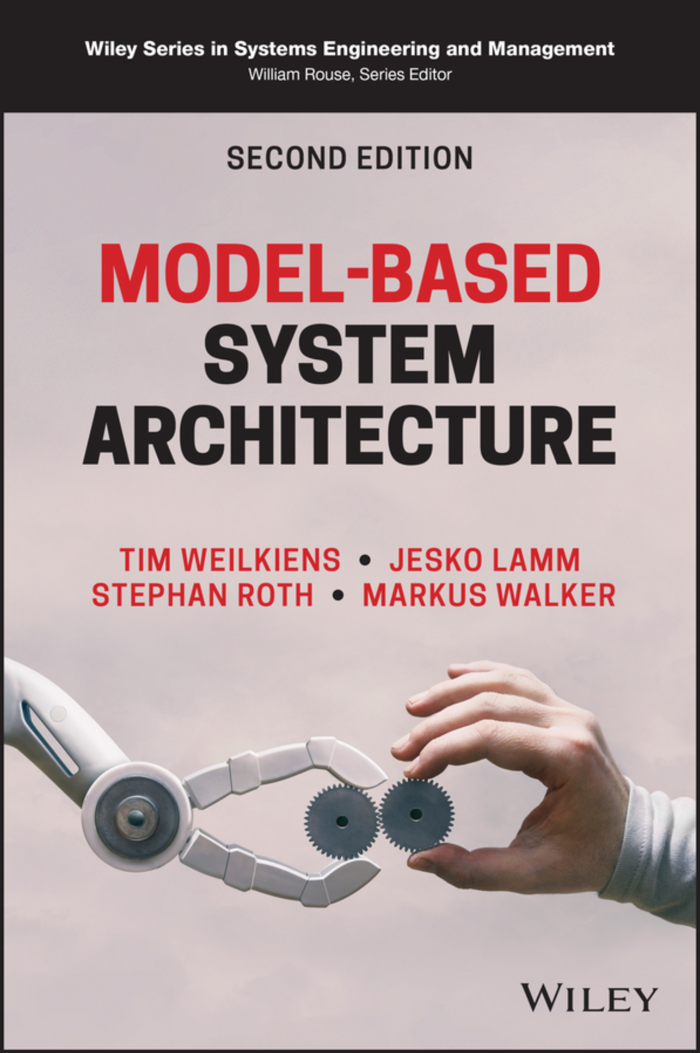
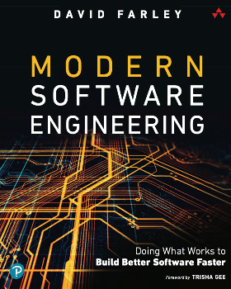
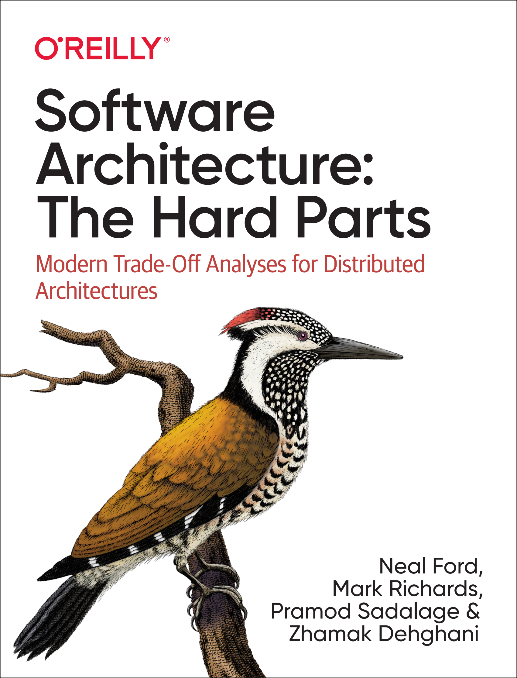
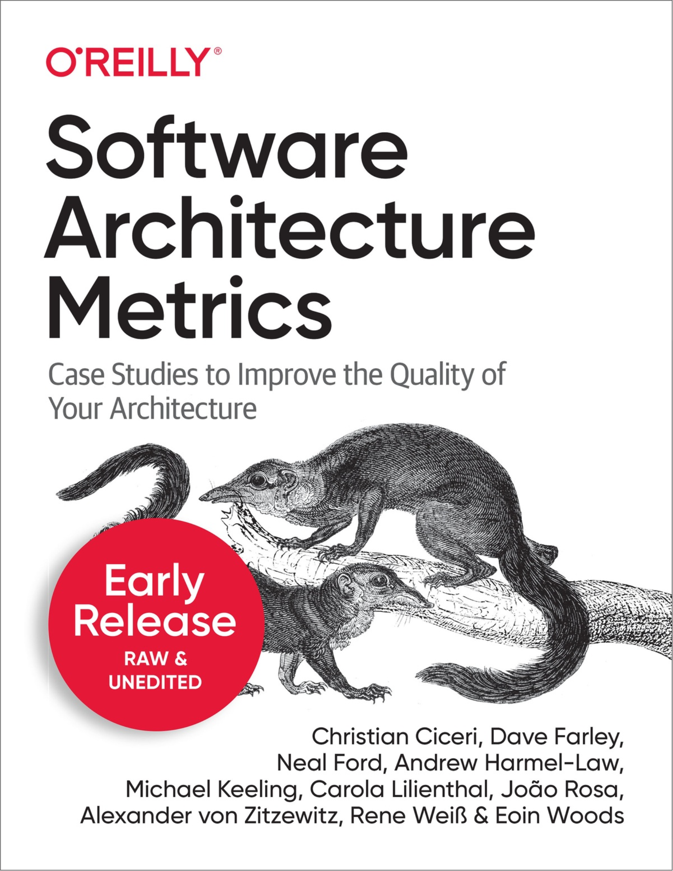
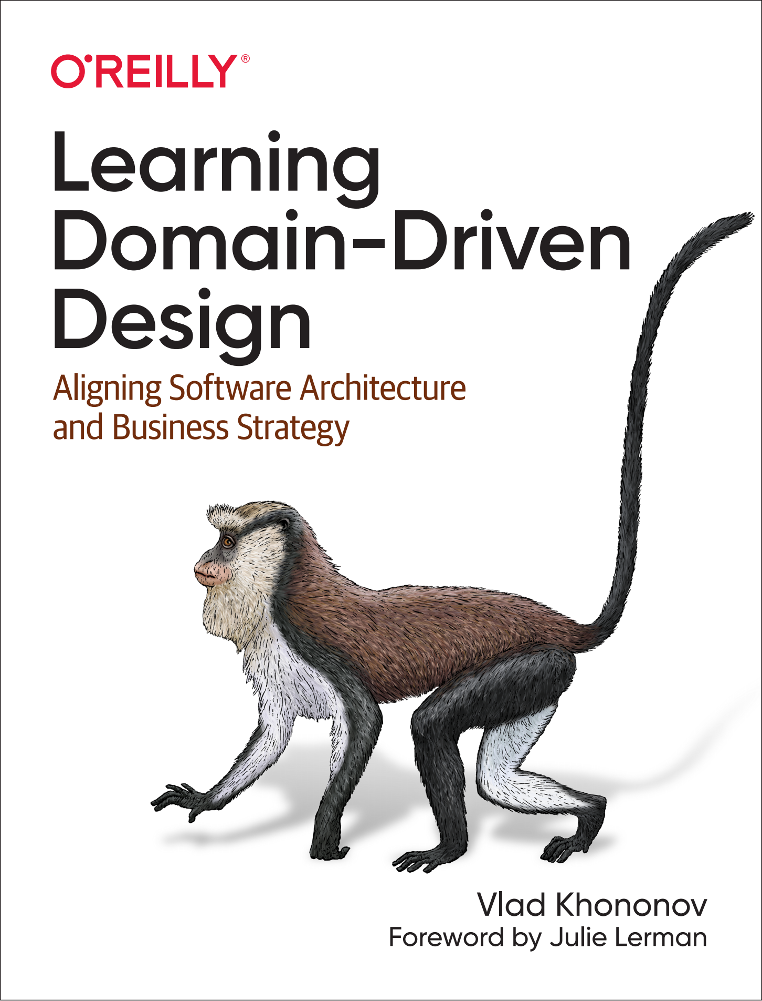
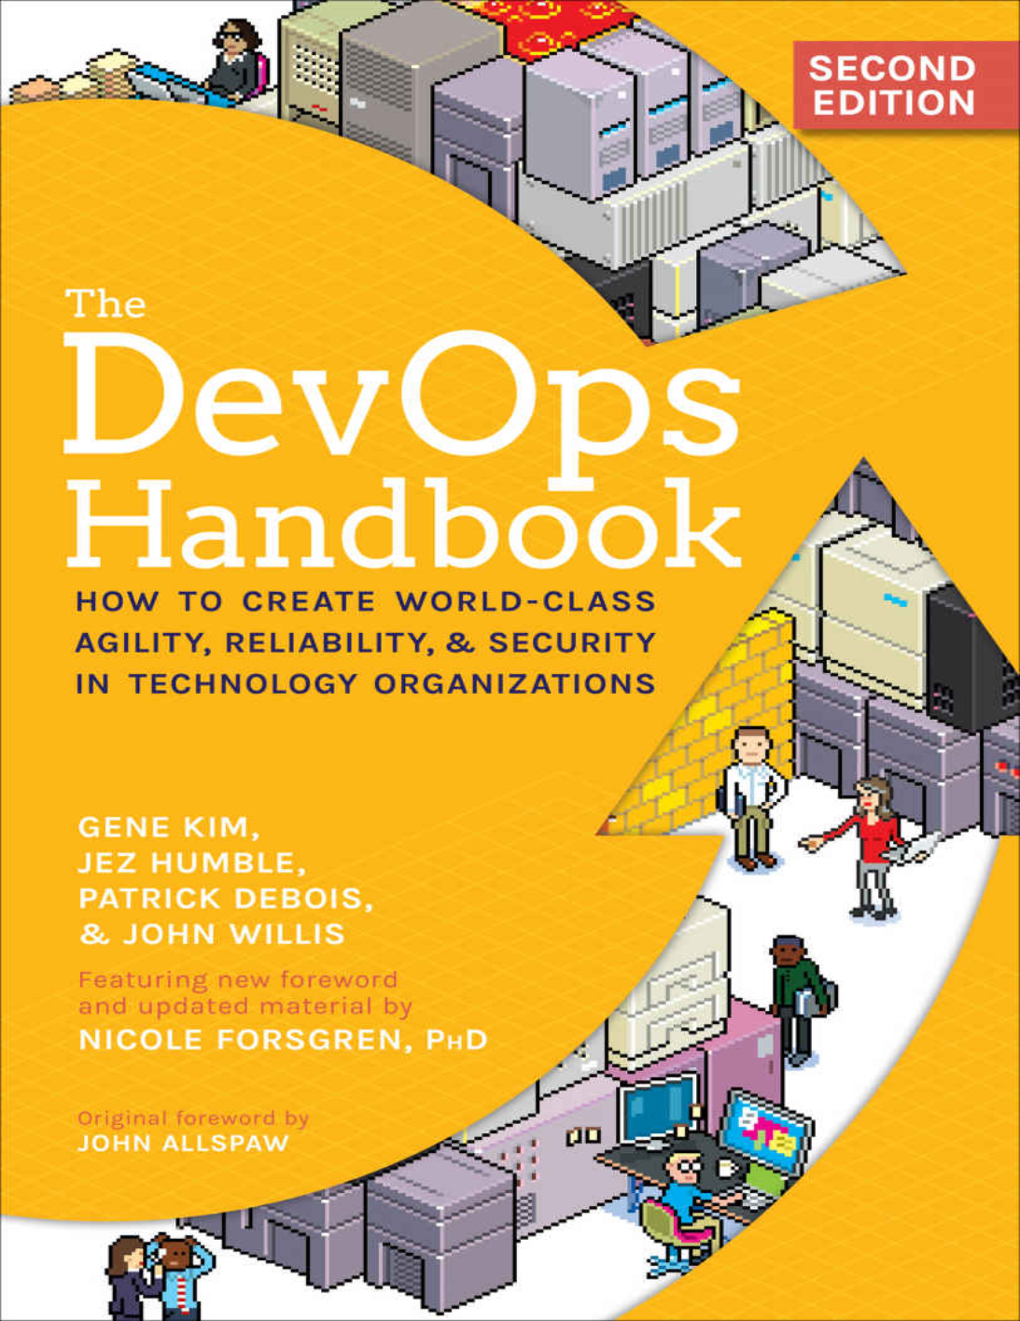
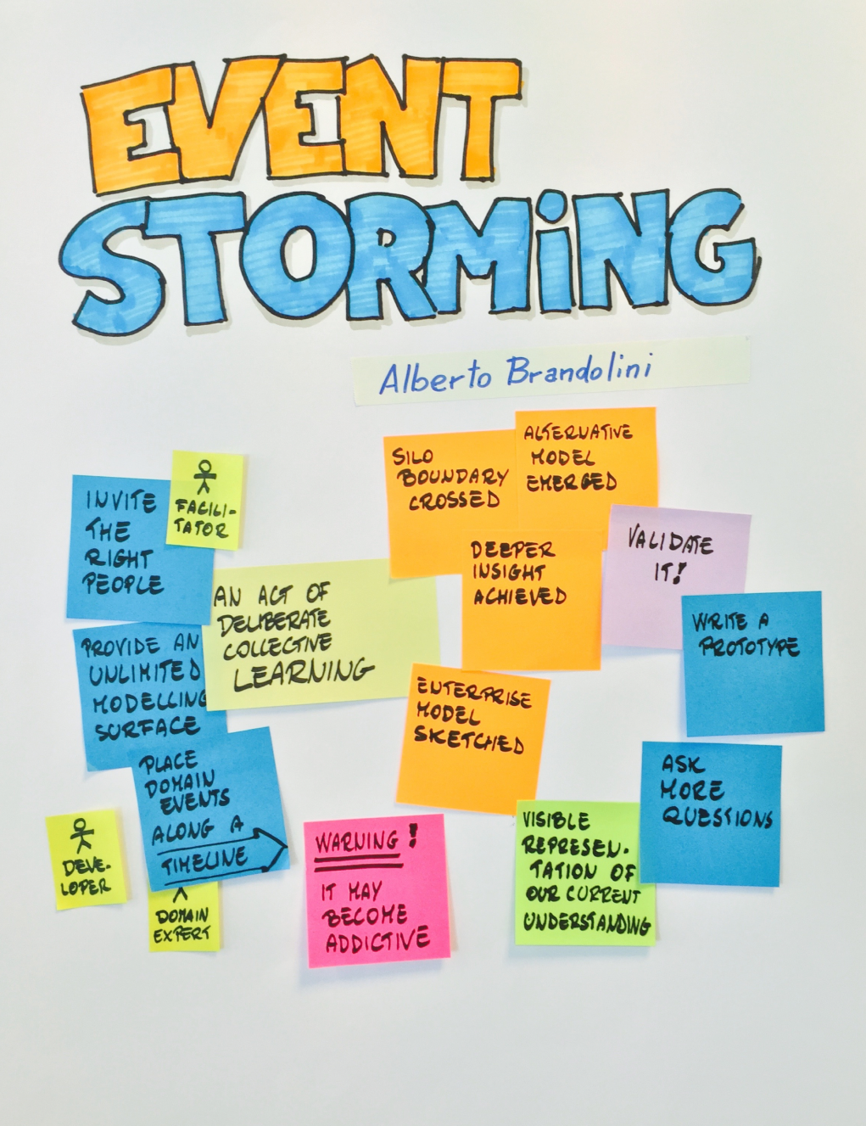
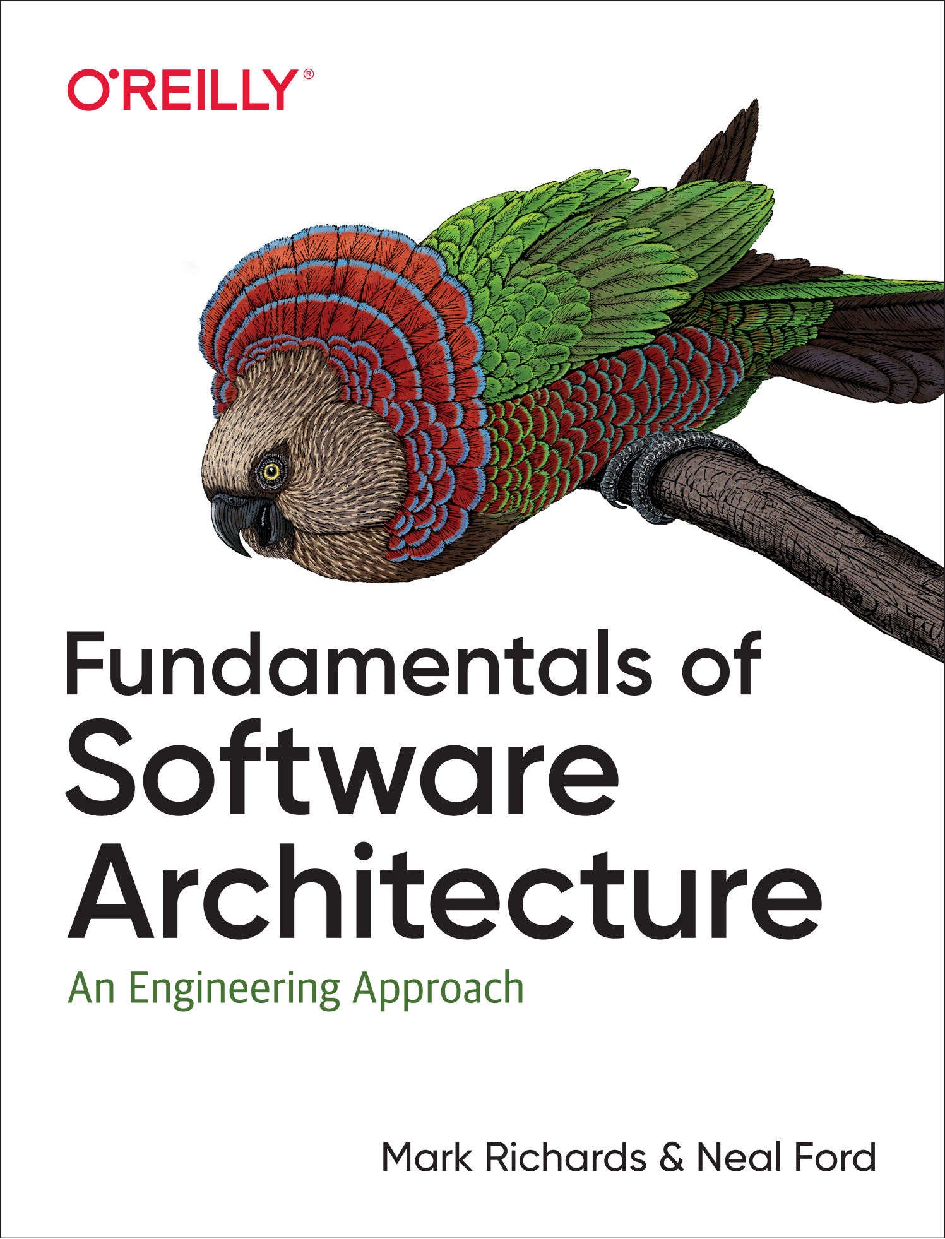
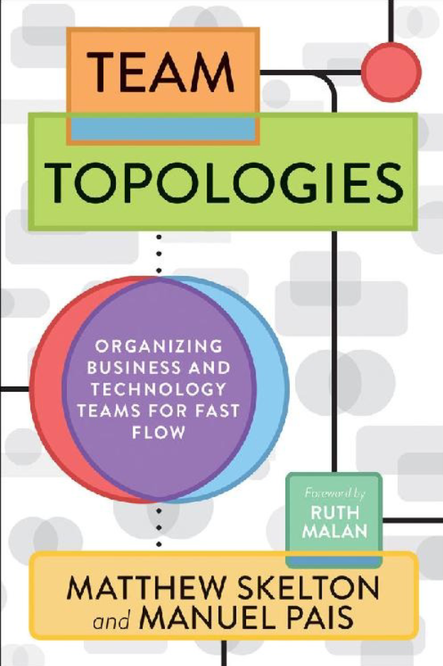
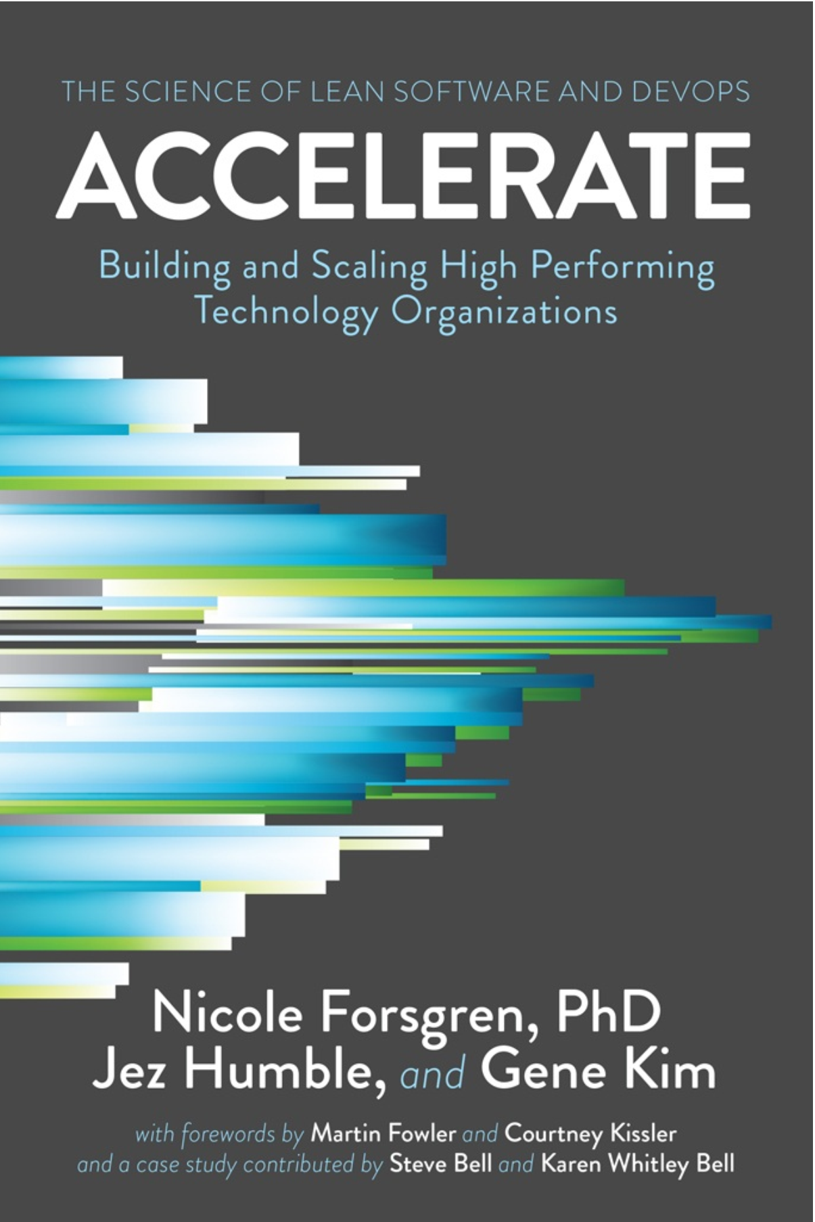
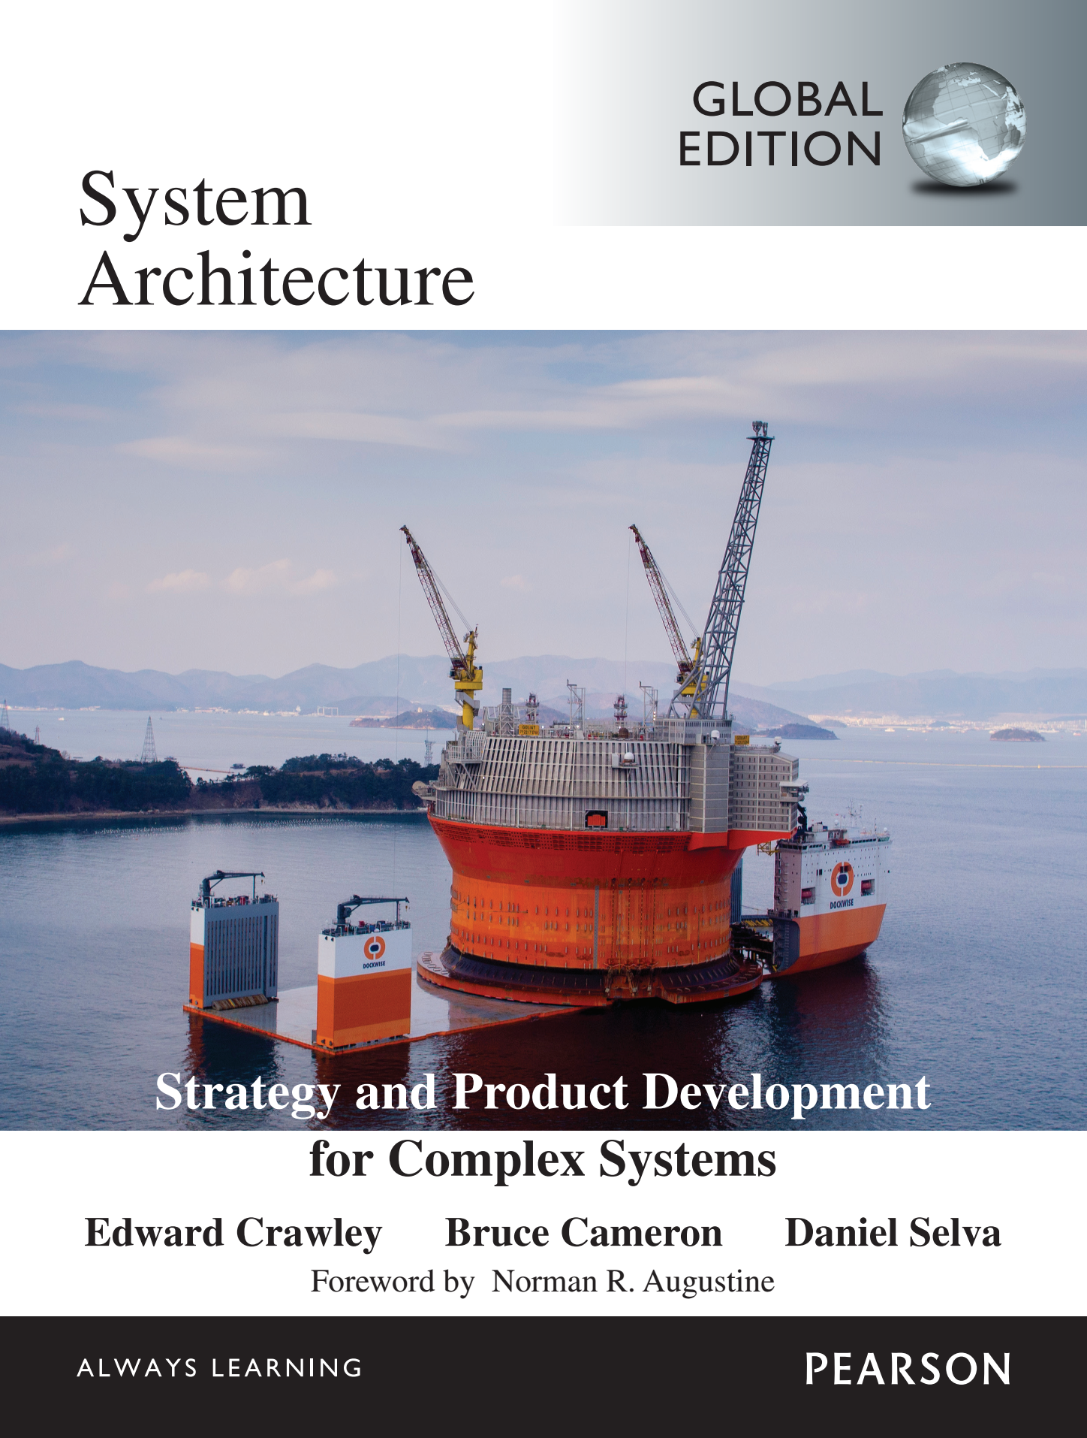
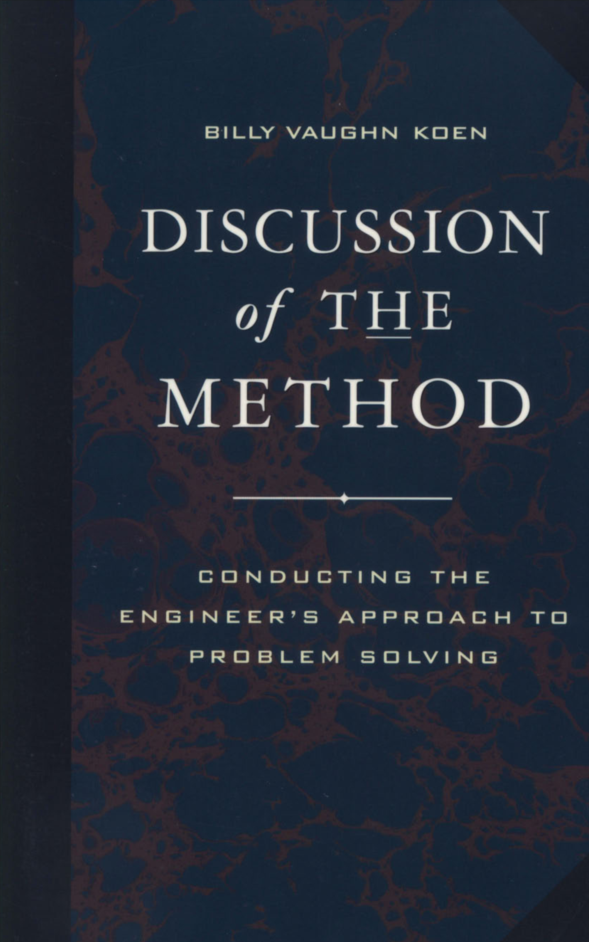
Literature in the «Systems Engineering» course (SoTA 20 textbooks, and 167 more footnotes)
2022
2022
2022
2022
2022
2021
2021
2020
2020
2019
2017
2017
2016
2015
2014
2011
2011
2009
2003

Slide 11
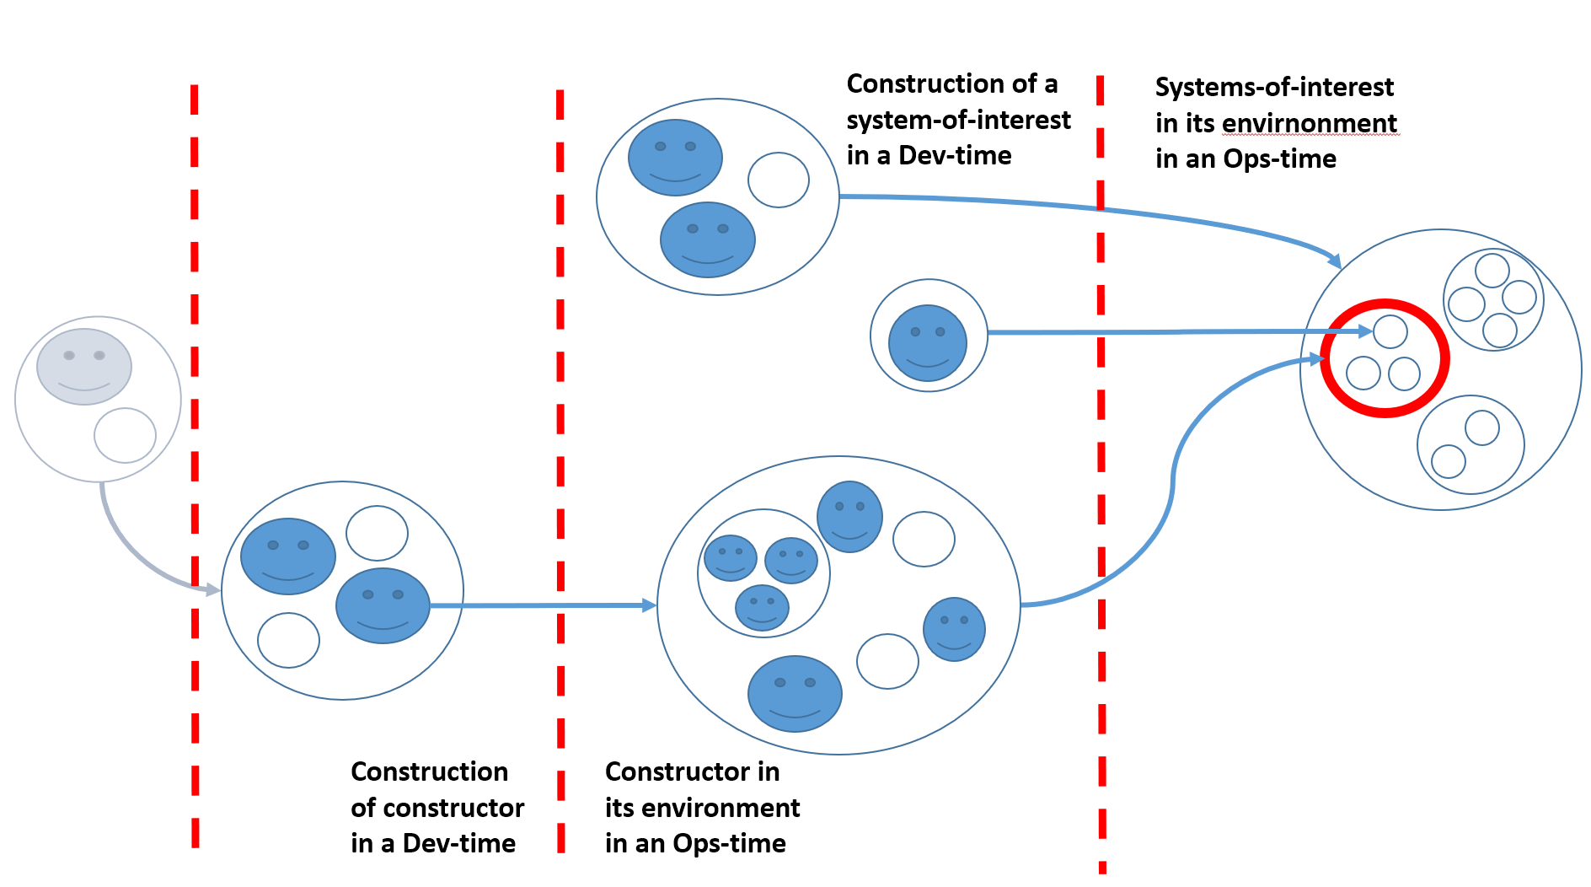
Essence of SoTA Systems Thinking
Memome here
Phenome here
Memome here
Phenome here

Slide 12
Test for the presence of systems thinking
Systematic is not systemic System thinking is the use of the concepts of systems approach for conceptual attention aiming and locking at important objects in activity / practice / labour / engineering. If there are system levels (suprasystem-system-subsystem) used in reasoning, then systems thinking at presence. If not, then it's reductionism or holism: ignoring emergence or the inevitable conflicts that lead to frustrations. An example where there is no systems thinking: "A building is made of bricks": truth, but useless truth. The building is conveniently considered to consist of walls, not bricks. And the walls are made of bricks, one another system level.

Slide 13
System Layers and Scalelessness
Population
Organism
Organ
Cell
Molecule
Came from physics (system and environment, emergent properties of system that consist of interacting parts) Watch emergence and increased complexity in each level – hooray, it works! (Bertalanffy) Self-organization and self-maintenance in biology and psychology -- autopoesis (Varela, Maturana) Multilevel Evolution and increase of complexity as a physical process (Vanchurin, Katznelson, Fields, Levin), scale-free description of complex systems
Evolutionary levels
Humankind
Society
Community
Organization
Person
Creature
Cyber-physical systems
Substance

Slide 14
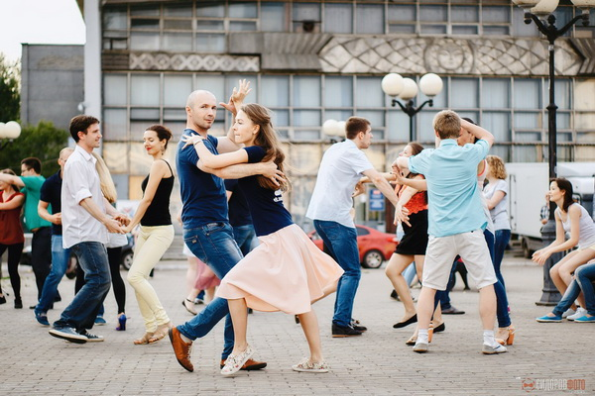
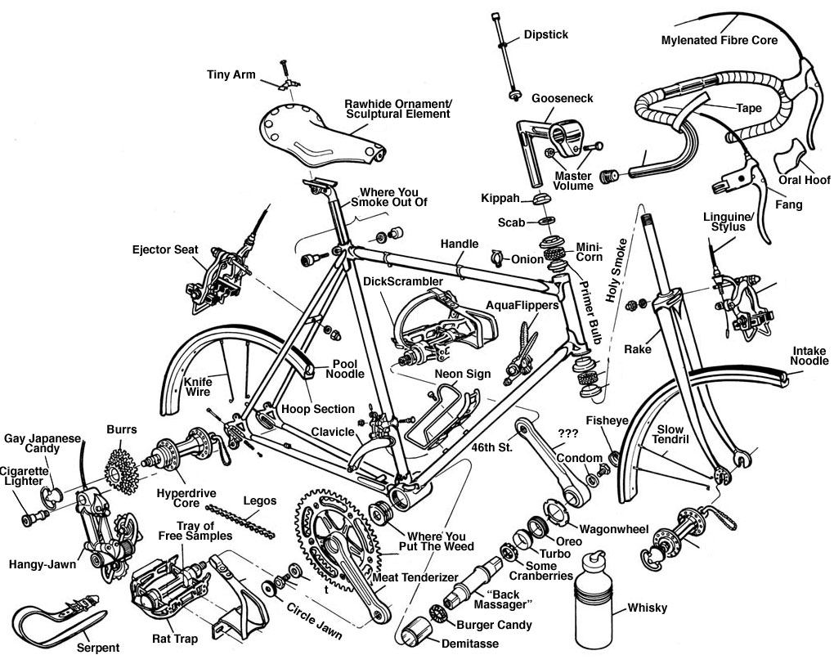
System levels selects by attention, not physically!
What you see here in a dance as a dynamic object?!
Not disassemble but select objects in construction (Dev-Time) decomposition by you attention.
Functional systems view of Ops-Time
Construction/module view of Dev-Time. This is affordances for Ops-Time. Completely another viepoint.
At the enterprise: everything is the same, but "dance“ together hundreds and thousands of people with a variety of things. Use your attention and 4D extensional ontology (with spatiotemporal parts)

Slide 15
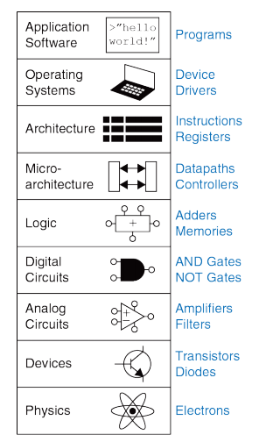
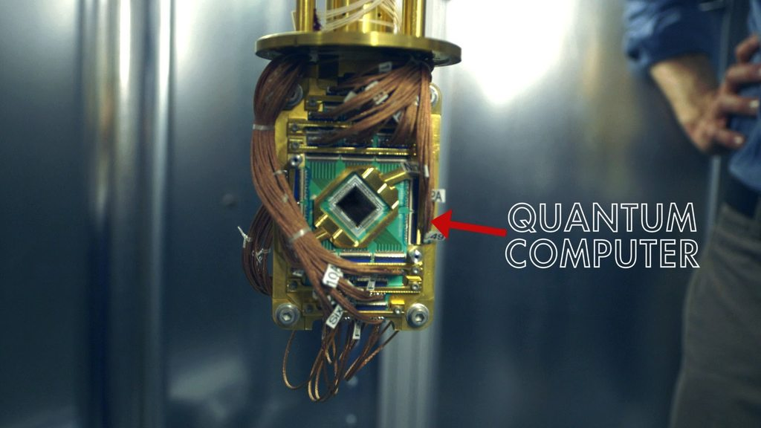
Disruption – from the lower (platform) system layers, not from the upper application layer!
And this is also curriculum plan for constructors (to know the practices of your level-of-interest and two neighboring ones)

Slide 16
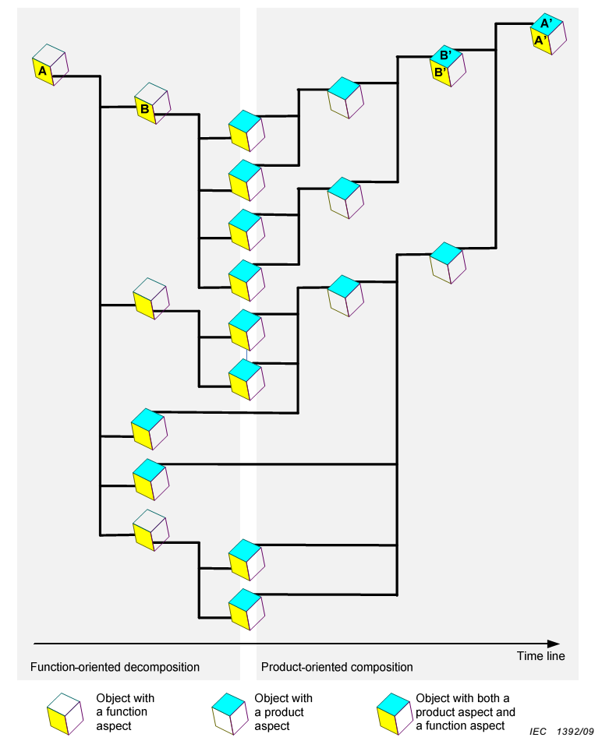
Operations concept, Systems concept, Architecture
Architecture (module and connectivity decisions for architectural concerns/ilities)
Operations concept. Use cases and unit tests as a description of the functionality of a black box + business case
System concept. Transparent Box Affordances for Achieving Black Box Functions
Product-manager (business case)
IEC 81346-1

Slide 17
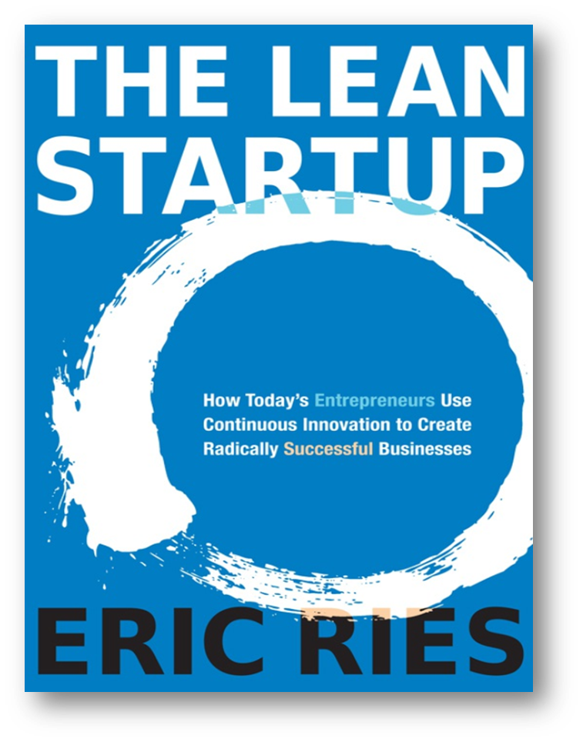
Entrepreneurship
Entrepreneurship and is a guesses/inventions about affordances (module synthesis). Objectives: active/embodied inference, reduce negative surprise (no reward function, but there is a function to prevent loss. "The action comes from dissatisfaction, possibly predicted" -- as in Ludwig von Mises praxeology) Theories and products are similar in terms of obtaining them (guesses and tests, the survivor wins after checks). Continuous development: it will not work from the first time (market/entrepreneurial hypotheses and experiments), and it is impossible to finish (continuous development/delivering/evolving) Most solutions are about equally useful, although they differ (frustrations and quasyoptimality) «Engineering of systems» should support all this similar to a «science of theories».
2011
All organizations are startups → all activities are entrepreneurial

Slide 18
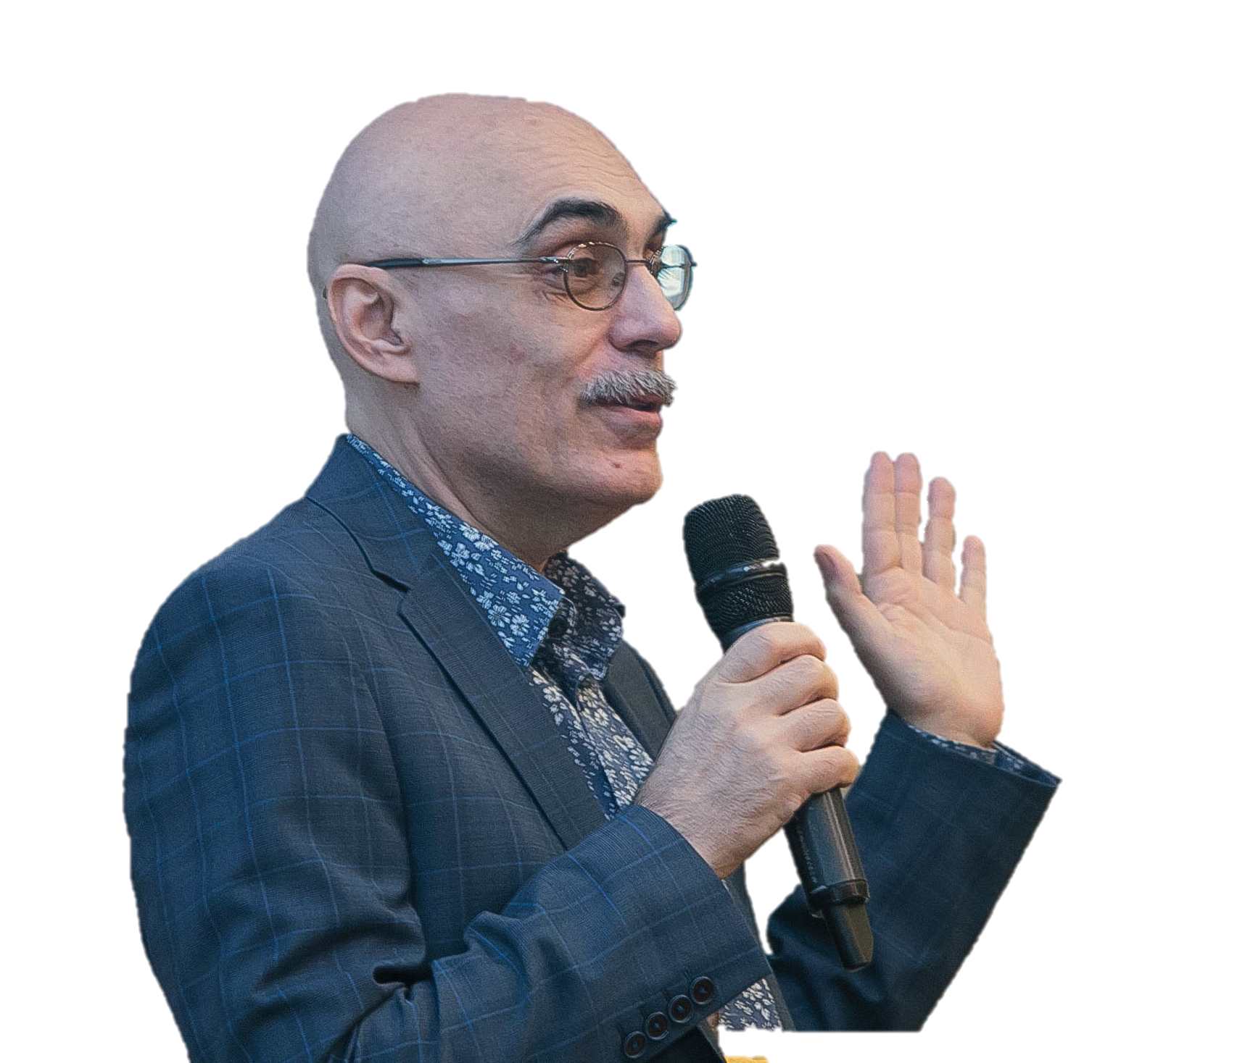
Thank you for your attention
Anatoly Levenchuk
https://www.linkedin.com/in/ailev/

